Slide 1
Crowdsourcing and Human Computation
Professor Chris Callison-Burch
http://crowdsourcing-class.org

Slide 2
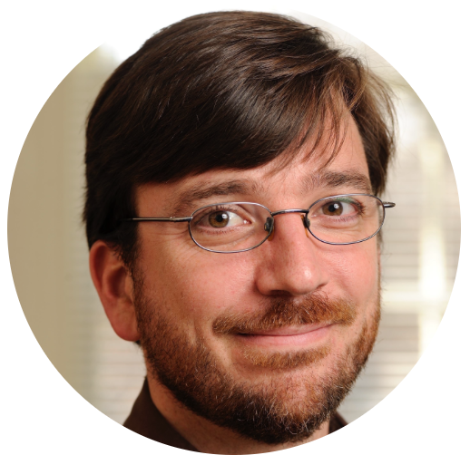
Chris Callison-Burch
Associate Professor in CIS
Undergrad from Stanford in Symbolic Systems
PhD from University of Edinburgh in Informatics
Research Faculty at Johns Hopkins University
Research Interests: Crowdsourcing, Artificial Intelligence, Natural Language Processing

Slide 3




Slide 4
Inter-related concepts
"Groups of individuals doing things collectively that seem intelligent”
Collective Intelligence
“A paradigm for utilizing human processing power to solve problems that computers cannot yet solve.”
The Sharing Economy
Human Computation
“An economic system in which assets or services are shared between private individuals, either for free or for a fee, typically by means of the Internet.”
Crowd-sourcing
“Outsourcing a job traditionally performed by an employee to an undefined, generally large group of people via open call.”
Data Mining
“Applying algorithms to extract patterns from data.”

Slide 5

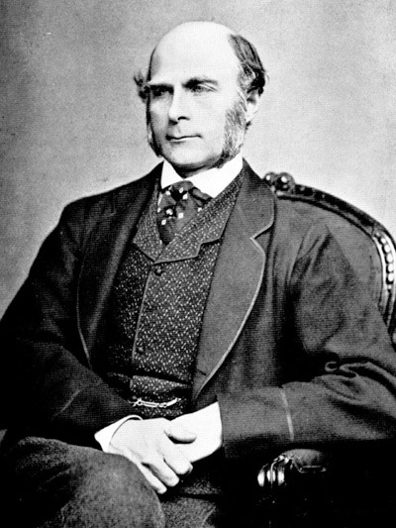
Francis Galton
Notes:
Sir Francis Galton cousin of Charles Darwin, was a Renaissance man. He was a anthropologist, tropical explorer, geographer, inventor, meteorologist, psychometrician, and statistician. He devised the first weather map, he invented the questionnaire, fingerprinting for ID. Plus contributions to statistics like Variance and standard deviation, Correlation and regression, etc. Like his cousin, he was also interested in the science of heredity. He was a eugenicist, and believed that only a very few people had the characteristics necessary to keep societies healthy.
He set up an “Anthropometric Laboratory,” where he used devices of his own making to test eye sight, hearing, color perception and reaction time. His experiments left him with little faith in the intelligence of the average person, “the stupidity and wrong-headedness of many men and women being so great as to be scarcely credible.” Only if power and control stayed in the hands of the select, well-bred few, Galton believed, could a society remain healthy and strong.

Slide 6
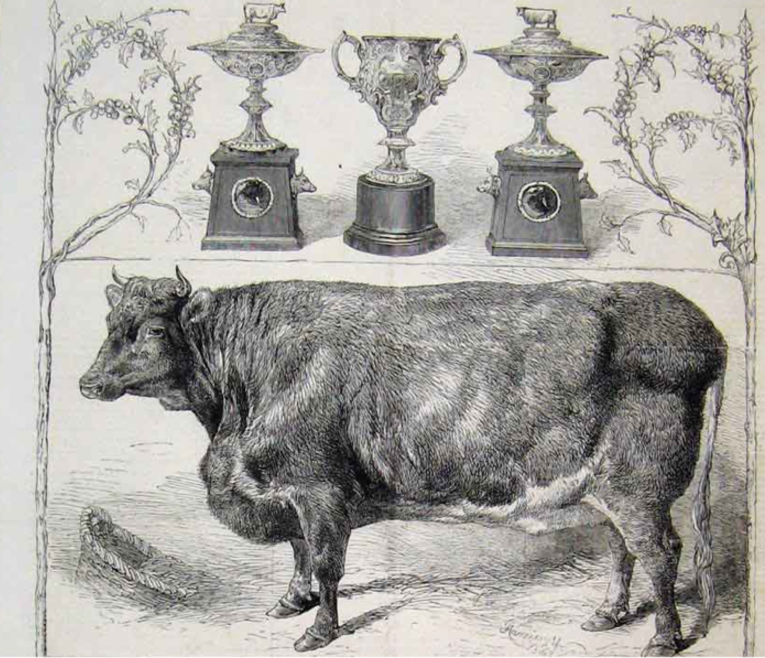
Notes:
Francis Galton published Vox Populi in Nature in 1907
weight-judging competition was carried on at the annual show of the West of England Fat Stock and Poultry Exhibition
787 participants paid a sixpenny fee to enter the contest
the mean estimate was off by <10lbs, or 0.8% from the true weight of 1198lbs
If you drew a random entry it was off by 37lbs or about 3%,
Galton believed that the participants were non-experts (e.g. not all of them were butchers, farmers, or cattlemen)
“This result is, I think, more creditable to the trust-worthiness of a democratic judgment than might have been expected.”
http://tomayko.com/writings/galtons-ox

Slide 7


Slide 8
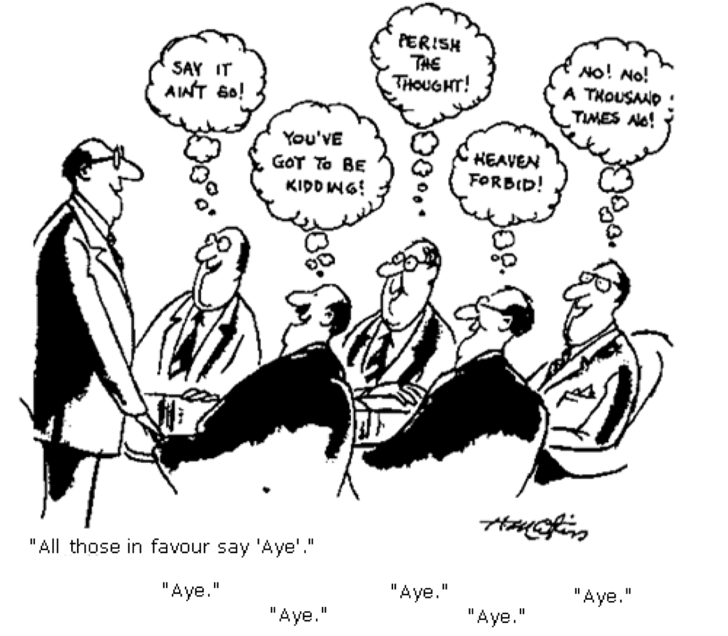
Collective Intelligence?
Groupthink
Groupthink is a psychological phenomenon that occurs within a group of people in which the desire for harmony or conformity in the group results in an irrational or dysfunctional decision-making outcome

Slide 9
Collective Intelligence?
Mob Mentality
Mob mentality, also called as herd mentality, describes how humans adopt behaviors, buy merchandise, and follow trends based on their circle of influence. It explains how one's point of view can be easily altered by those around them.
Notes:
https://inpathybulletin.com/what-is-mob-mentality/

Slide 10
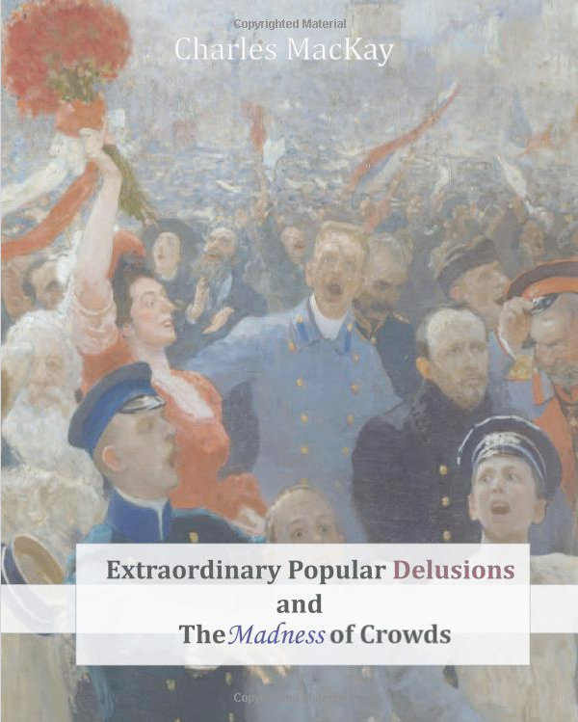
Popular Delusions and the Madness of Crowds
Economic bubbles
Alchemy & Psuedoscience
Witch hunts
Prophecies
Notes:
Book first published in 1847 by Scottish Journalist Charles MacKay
the Dutch tulip mania of the early seventeenth century. According to Mackay, during this bubble, speculators from all walks of life bought and sold tulip bulbs and even futures contracts on them. Allegedly some tulip bulb varieties briefly became the most expensive objects in the world during 1637.
http://en.wikipedia.org/wiki/Extraordinary_Popular_Delusions_and_the_Madness_of_Crowds

Slide 11
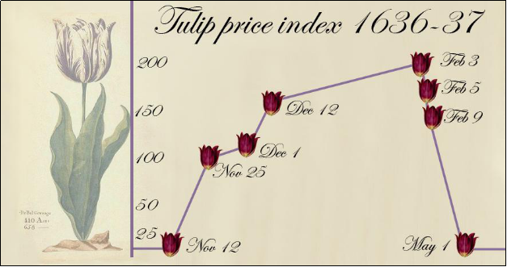
Notes:
https://en.wikipedia.org/wiki/Tulip_mania A tulip, known as "the Viceroy" (viseroij), displayed in the 1637 Dutch catalog Verzameling van een Meenigte Tulipaanen. Its bulb was offered for sale for between 3,000 and 4,200 guilders (florins) depending on weight (gewooge). A skilled craftsworker at the time earned about 300 guilders a year.^{[1]}

Slide 12
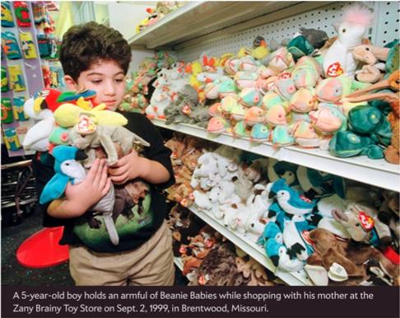
Notes:
https://slate.com/technology/2015/02/beanie-babies-bubble-economics-and-psychology-of-a-plush-toy-investment-craze.html
"Looking back, it’s clear that the Beanie Baby craze was an economic bubble, fueled by frenzied speculation and blatantly baseless optimism. Bubbles are quite common, but bubbles over toys are not."

Slide 13
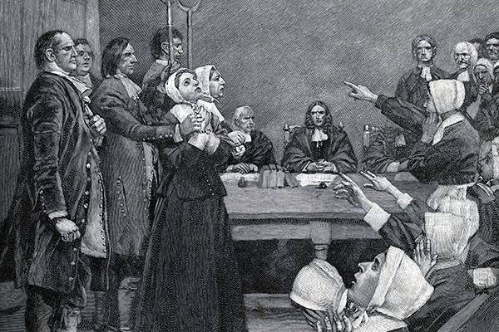
Salem Witch Trials
Notes:
Witch Hunt – https://inpathybulletin.com/what-is-mob-mentality/
Perhaps one of the most enduring examples of mob mentality is that of The Salem Witch Trials, wherein an entire population came to believe that completely innocent victims were witches possessed by the devil. They arrived at this conclusion without any physical or rational evidence. There was simply a snowball effect once one person claimed to see the devil, claimed a conspiracy of witches, and then accused another woman of being a witch. Widespread panic ensued. Women were lynched one right after the other without a fair or reasonable trial because, by that point, those making the determination were incapable of fair reasoning. They had already been entirely swayed by mob mentality.
The Salem witch trials were a series of hearings and prosecutions of people accused of witchcraft in colonial Massachusetts between February 1692 and May 1693. More than two hundred people were accused. Thirty were found guilty, nineteen of whom were executed by hanging (fourteen women and five men). One other man, Giles Corey, was pressed to death for refusing to plead, and at least five people died in jail.^{[1]}
https://en.wikipedia.org/wiki/Salem_witch_trials

Slide 14

Notes:
Prophecies
QAnon^{[a]} (/ˌkjuːəˈnɒn/) is a disproven and discredited far-right conspiracy theory^{[1]} alleging that a cabal of Satan-worshipping cannibalistic^{[2][3][4]} pedophilesis running a global child sex-trafficking ring and plotting against former U.S. president Donald Trump, who is fighting the cabal.^{[5]} U.S. prosecutors have called it "a group commonly referred to as a cult".^{[6]}
QAnon also commonly asserts that Trump is planning a day of reckoning known as the "Storm", when thousands of members of the cabal will be arrested
Some QAnon followers spent weeks preparing for a nationwide blackout starting at noon on Inauguration Day, warning friends and family in text chains and Facebook messages to buy CB radios and stock up on food. They believed Trump would announce martial law through the Emergency Alert System before carrying out mass arrests.
https://www.nbcnews.com/tech/internet/some-qanon-followers-struggle-inauguration-day-n1255002

Slide 15
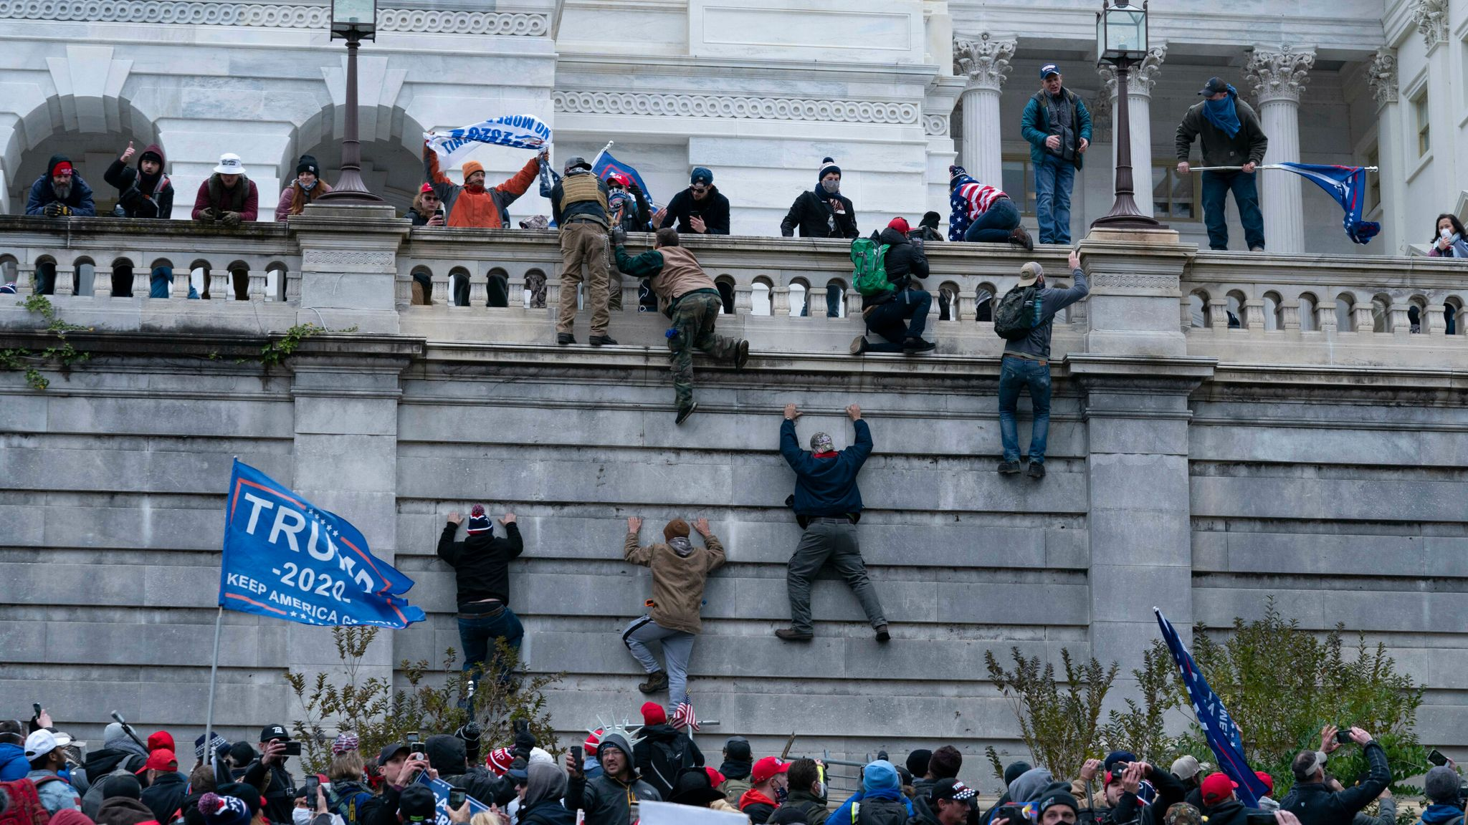
Notes:
https://en.wikipedia.org/wiki/2021_storming_of_the_United_States_Capitol
The storming of the United States Capitol was a riot and violent attack against the 117th United States Congress at the United States Capitol on January 6, 2021, carried out by a mob of supporters of President Donald Trump in an attempt to overturn his defeat in the 2020 presidential election.^{[2]} The riot led to the evacuation and lockdown of the Capitol, and five deaths.
Called to action by Trump,^{[40]} thousands^{[41]} of his supporters gathered in Washington, D.C., on January 5 and 6 in support of his claim that the 2020 election had been "stolen" from him,^{[42]} and to demand that Vice President Mike Pence and Congress reject President-elect Joe Biden's victory.^{[43][44][45]} On the morning of January 6, at a "Save America" rally on the Ellipse, Rudy Giuliani called for "trial by combat";^{[46][47]} Donald Trump Jr. threatened the president's opponents by saying "we're coming for you", having previously called for "total war";^{[48][49]} and Trump repeated his false claims about election irregularities and told the crowd to "fight like hell".^{[50]:01:11:44} At the president's encouragement,^{[51]}thousands of the crowd then walked to the Capitol, where a joint session of Congress was beginning the Electoral College vote count to formalize Biden's victory.
Many of the crowd at the Capitol, some of whom had gathered earlier, breached police perimeters and, many shouting,^{[52]} stormed the building.^{[53]} These rioters occupied, vandalized,^{[54][55]} and looted^{[56]} parts of the building for several hours.^{[57][58]} Many became violent, assaulting Capitol Police officers and reporters, erecting a gallows on the Capitol grounds, and attempting to locate lawmakers to take hostage and harm. They chanted "Hang Mike Pence",^{[59]} blaming him for not rejecting the Electoral College votes, although he lacked the constitutional authority to do so.^{[60]} The rioters targeted House Speaker Nancy Pelosi (D–CA), House Speaker^{[61][62]} vandalizing and looting^{[63]} her offices, as well as those of other members of Congress.^{[64]} Dozens of people in Washington, D.C., that day were later found to be listed in the FBI's Terrorist Screening Database, most as suspected white supremacists.^{[65]} Members of a paramilitary anti-government group were indicted on conspiracy charges for allegedly staging a planned mission in the Capitol.^{[66][67]}
Upon security being breached, Capitol Police evacuated the Senate and House of Representatives chambers. Several buildings in the Capitol complex were evacuated, and all were locked down.^{[68]} Rioters occupied and ransacked the empty Senate chamber while federal law enforcement officers drew handguns to defend the evacuated House floor.^{[69][70]} Improvised explosive devices were found near the Capitol grounds, as well as at offices of the Democratic National Committee, the Republican National Committee, and in a nearby vehicle.^{[71][72]} Five people, including Capitol Police officer Brian Sicknick, died from the events, while dozens more were injured.^{[73]}

Slide 16

Wisdom of Crowds
Requirements for crowds to be wise:
Diversity of Opinion
Independence
De-centralization
Aggregation

Slide 17
Groups / Crowds
Employees of a business
Participants in a poll
Sports fans betting on games
Independent stock market investors
Internet users linking to sites
Citizens in a democracy

Slide 18
Ways of aggregating collective intelligence
Point spreads / parimutuel odds
Stock prices
Futures contracts
Voting
Computer algorithms, interfaces

Slide 19
Crowdsourcing Example: Disaster Response

Slide 20
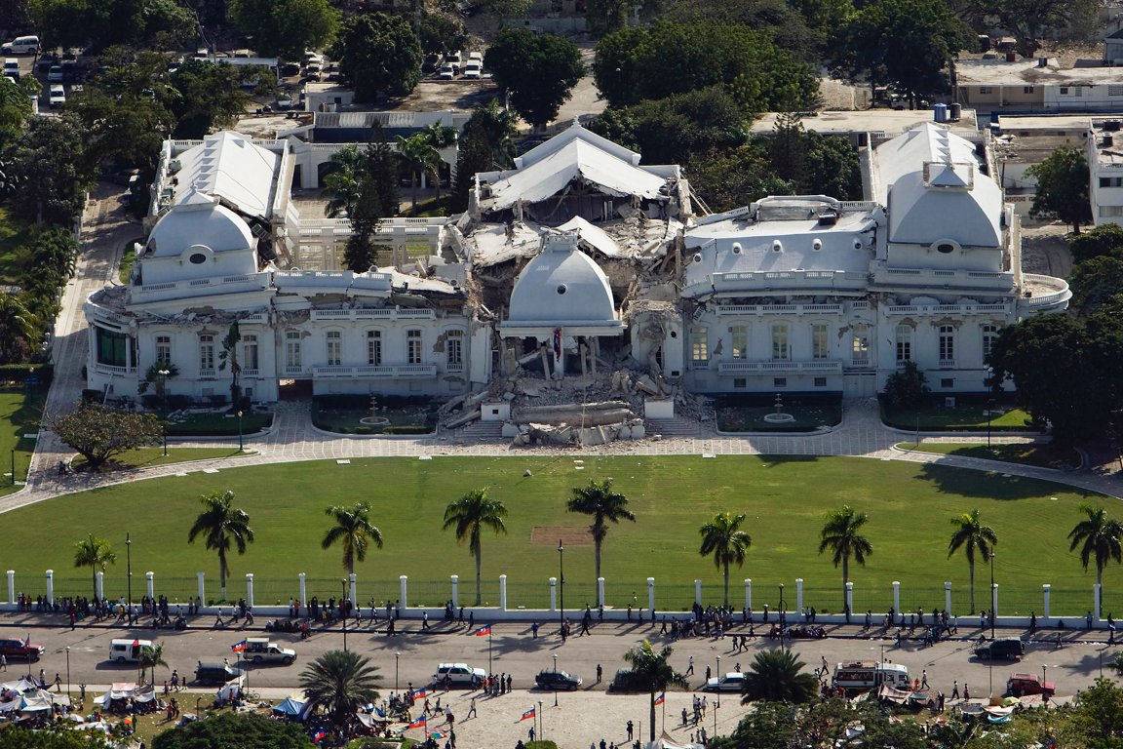
Notes:
In the wake of the 2010 Haitian earthquake, much of the country’s conventional emergency response services failed. Since cell phone towers remained standing after the earthquake, text messages were a viable mode of communication. Munro (2010) describes how a text-message-based emergency reporting system was set up by a consortium of volunteer organizations named “Mission 4636” after a free SMS short code telephone number that they established. The SMS messages were routed to a system for reporting trapped people and other emergencies. Search and rescue teams within Haiti, including the US Military, recognized the quantity and reliability of actionable information in these messages and used them to provide aid.
The majority of the SMS messages were written in Haitian Creole, which was not spoken by most of first responders deployed from overseas. A distributed, online translation effort was established, drawing volunteers from Haitian Creoleand French-speaking communities around the world. The volunteers not only translated messages, but also categorized them and pinpointed them on a map.5 Collaborating online, they employed their local knowledge of locations, regional slang, abbreviations and spelling variants to process more than 40,000 messages in the first six weeks alone. First responders indicated that this volunteer effort helped to save hundreds of lives and helped direct the first food and aid to tens of thousands.

Slide 21
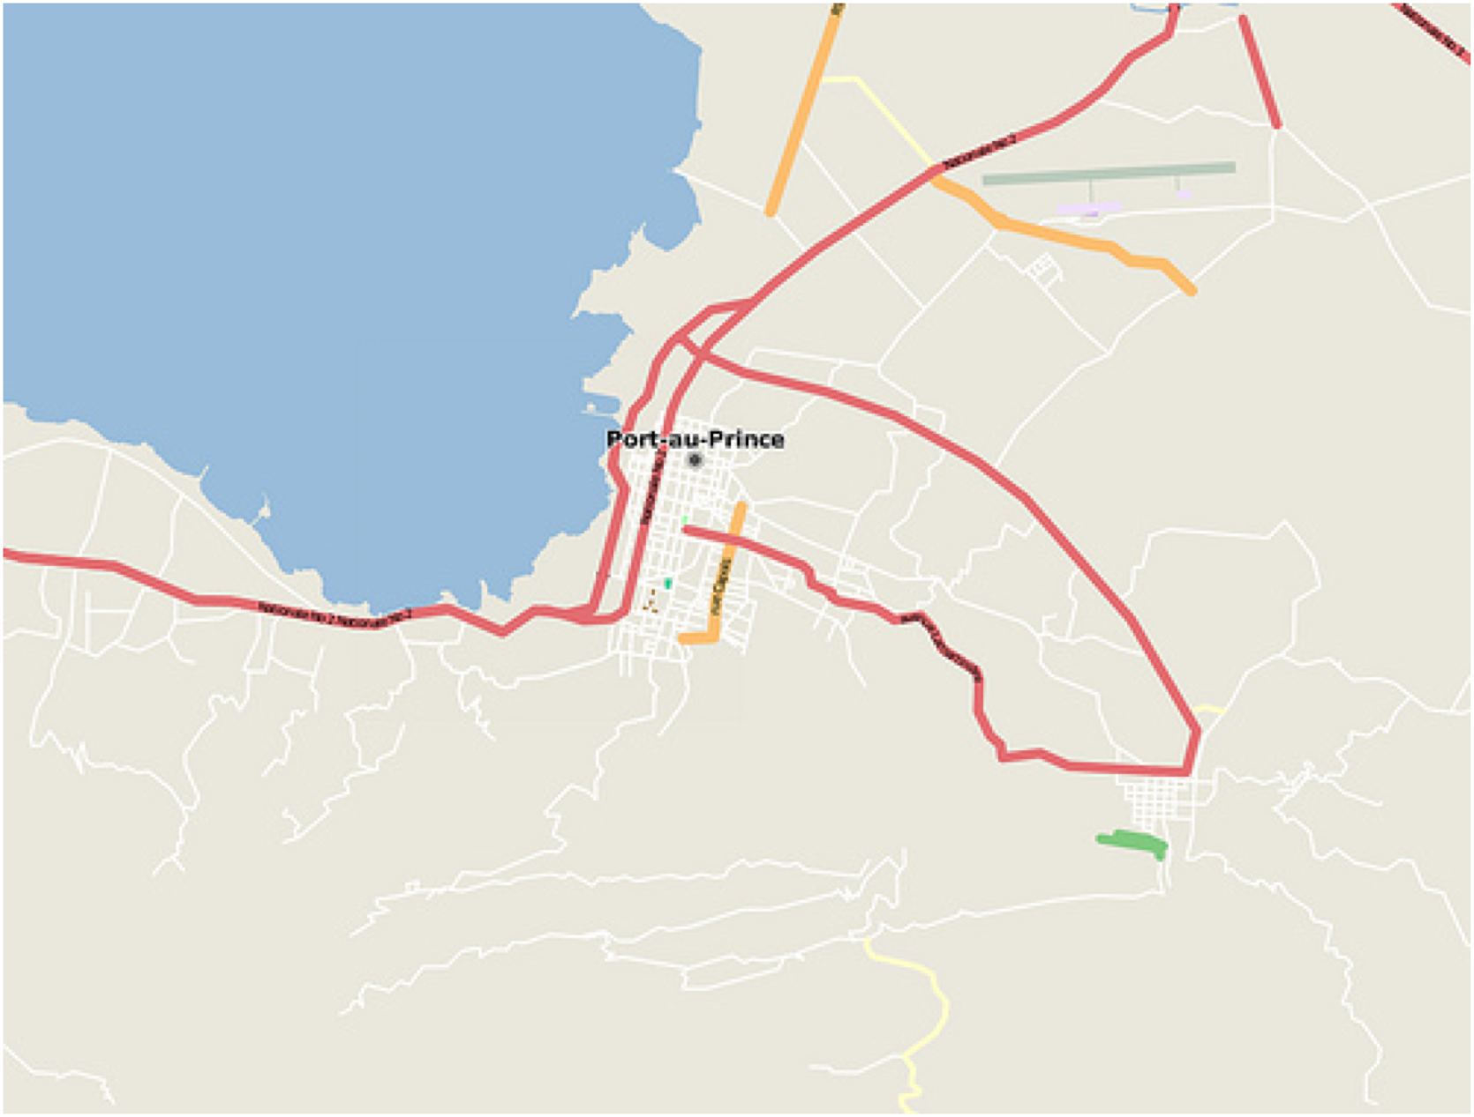
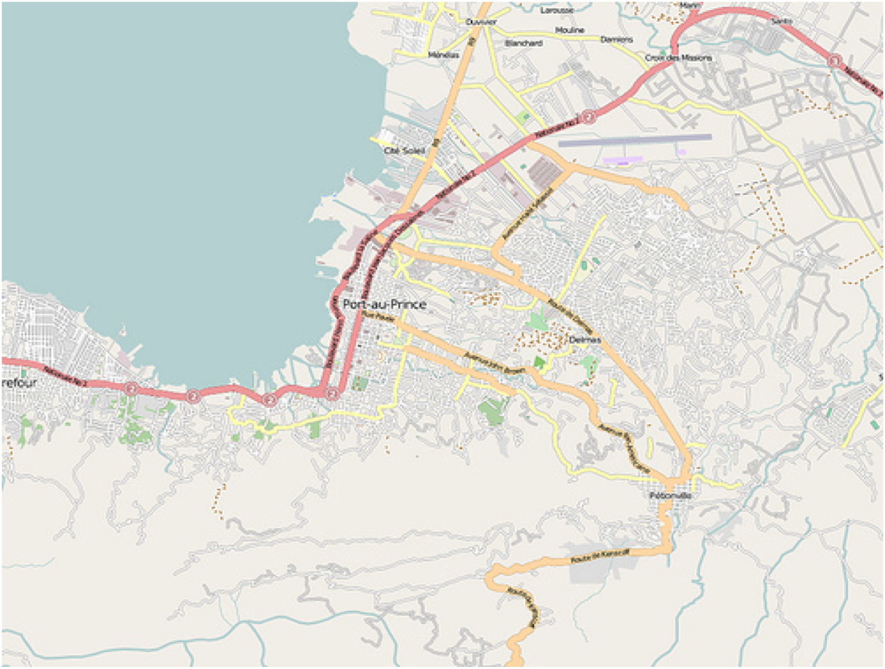

Disaster Response: Better maps from Crowdsourcing
Jan 12, 2010
Jan 23, 2010
Robert Munro

Slide 22
Disaster Response: The responders don’t speak Kreyol
Fanmi mwen nan Kafou, 24 Cote Plage, 41A bezwen manje ak dlo
Moun kwense nan Sakre Kè nan Pòtoprens
Ti ekipman Lopital General genyen yo paka minm fè 24 è
Fanm gen tranche pou fè yon pitit nan Delmas 31
My family in Carrefour, 24 Cote Plage,41A needs food and water
People trapped in Sacred Heart Church, PauP
General Hospital has less than 24 hrs. supplies
Undergoing children delivery Delmas 31

Slide 23
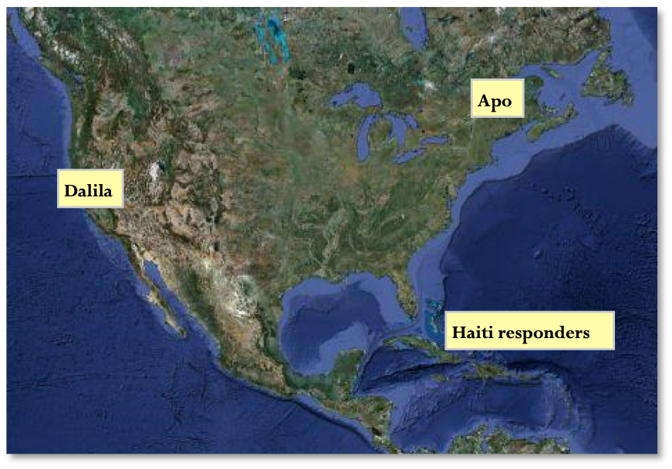
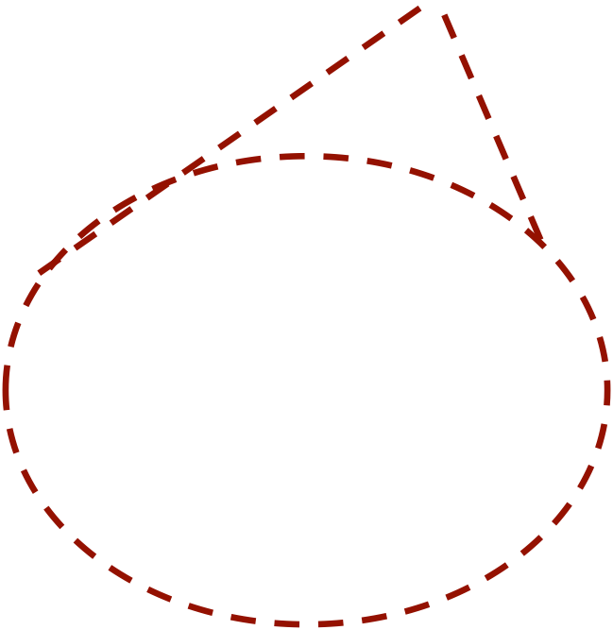
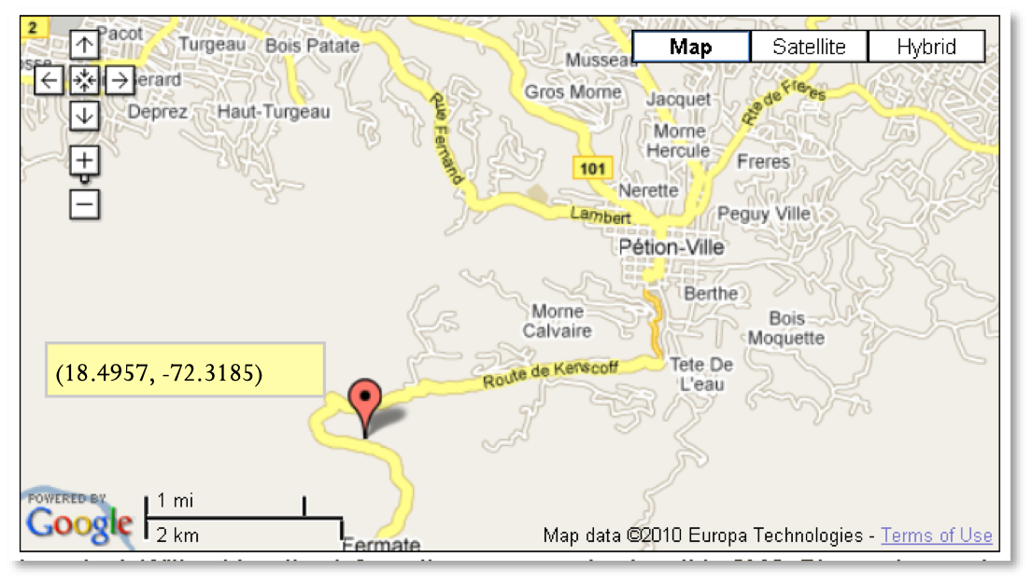
Disaster Response: Maps + Translation + Local Knowledge
Workers collaborated to find locations:
Dalila: I need Thomassin Apo please
Apo: Kenscoff Route: Lat: 18.495746829274168, Long:-72.31849193572998
Apo: This Area after Petion-Ville and Pelerin 5 is not on Google Map. We have no streets name
Apo: I know this place like my pocket
Dalila: thank God u was here
Feedback from responders:
"just got emergency SMS, child delivery, USCG are acting, and, the GPS coordinates of the location we got from someone of your team were 100% accurate!"
Robert Munro

Slide 24
Disaster Response: Testimonials
Clark Craig of the Marine Corps:
“I cannot overemphasize to you what the work of the Ushahidi/Haiti has provided. It is saving lives every day.”
Secretary of State Hillary Clinton:
“The technology community has set up interactive maps to help us identify needs and target resources. And on Monday, a seven-year-old girl and two women were pulled from the rubble of a collapsed supermarket by an American search-and-rescue team after they sent a text message calling for help.”
Craig Fulgate, FEMA Task Force:
“[The] Crisis Map of Haiti represents the most comprehensive and up-to-date map available to the humanitarian community.”
Ushahidi@Tufts :
“The World Food Program delivered food to an informal camp of 2500 people, having yet to receive food or water, in Diquini to a location that 4636 had identified for them.”
Robert Munro

Slide 25
Citizen Science

Slide 26
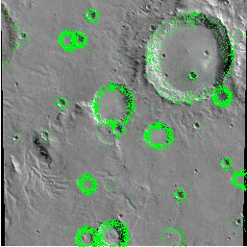
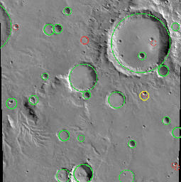
NASA Clickworkers (2000)
NASA showed that public volunteers could do routine science analysis that would normally be done by a graduate student working for months on end. From 11/2000 to 1/2002, they had 101,000 clickworkers volunteering 14,000 work hours, 612,832 sessions, and 2,378,820 entries!
We try to have several people cover each region on Mars so that we can compute a consensus, throwing out any mistaken or frivolous entries and averaging out the inaccuracies.
Here are all the clicks we received for this region
Here is the consensus
Notes:
http://nasaclickworkers.com/classic/

Slide 27
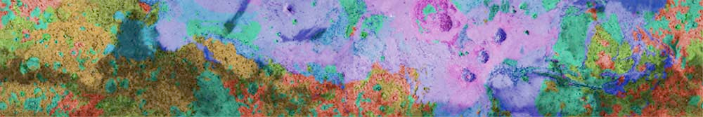
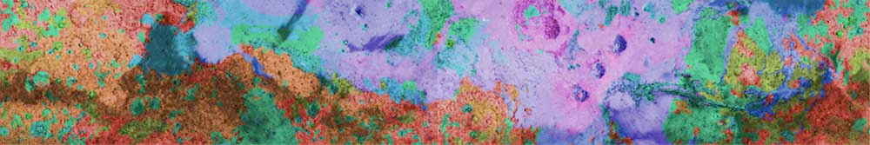
NASA Clickworkers (2000)
Mars age map produced directly from clickworker inputs.
Mars age map produced from scientists
Color guide: red=heavily cratered (old), green=medium, violet=lightly cratered (young).
Notes:
One science product that can be produced directly from all your clicks is a map of the geologic ages of different regions of Mars. Since crater bombardment is assumed to be constant, the longer it has been since a region has had water washing over it (or lava, or sand dunes, or a big recent impact, etc.) to resurface it, the more craters it has had time to accumulate

Slide 28

Zooniverse
https://www.zooniverse.org
Notes:
https://www.zooniverse.org

Slide 29

Zooniverse
https://www.zooniverse.org
Notes:
https://www.zooniverse.org

Slide 30

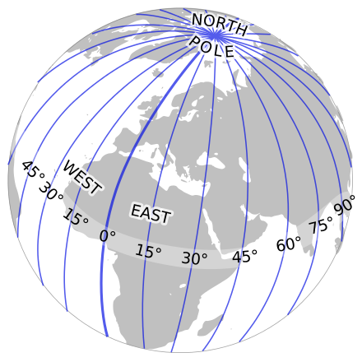
Longitude rewards
Notes:
https://en.wikipedia.org/wiki/Longitude_rewards
The longitude problem[edit]
The measurement of longitude was a problem that came into sharp focus as people began making transoceanic voyages. Determining latitude was relatively easy in that it could be found from the altitude of the sun at noon with the aid of a table giving the sun's declination for the day.^{[4]} For longitude, early ocean navigators had to rely on dead reckoning, based on calculations of the vessel's heading and speed for a given time (much of which was based on intuition on the part of the master and/or navigator). This was inaccurate on long voyages out of sight of land
The Longitude Act 1714 was an Act of Parliament of Great Britain passed in July 1714 at the end of the reign of Queen Anne. It established the Board of Longitude and offered monetary rewards (Longitude rewards) for anyone who could find a simple and practical method for the precise determination of a ship's longitude. The Act of 1714 was followed by a series of other Longitude Acts that revised or replaced the original.^{[1]}
£10,000 (equivalent to £1.3 million in 2015^{[10]}) for a method that could determine longitude within 1 degree (equivalent to 60 nautical miles (110 km; 69 mi) at the equator).
£15,000 (equivalent to £1.96 million in 2015^{[10]}) for a method that could determine longitude within 40 minutes
£20,000 (equivalent to £2.61 million in 2015^{[10]}) for a method that could determine longitude within 30 minutes

Slide 31
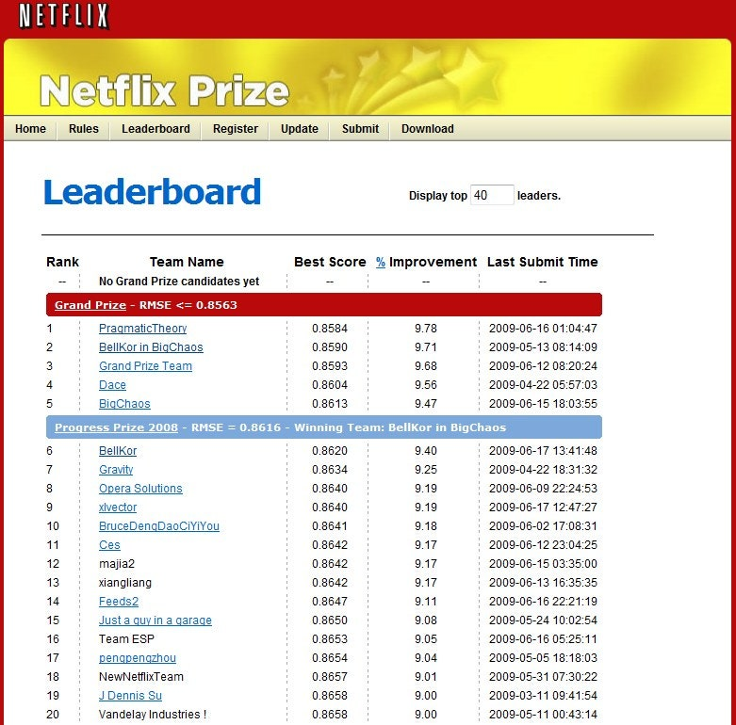
Notes:
https://en.wikipedia.org/wiki/Netflix_Prize

Slide 32
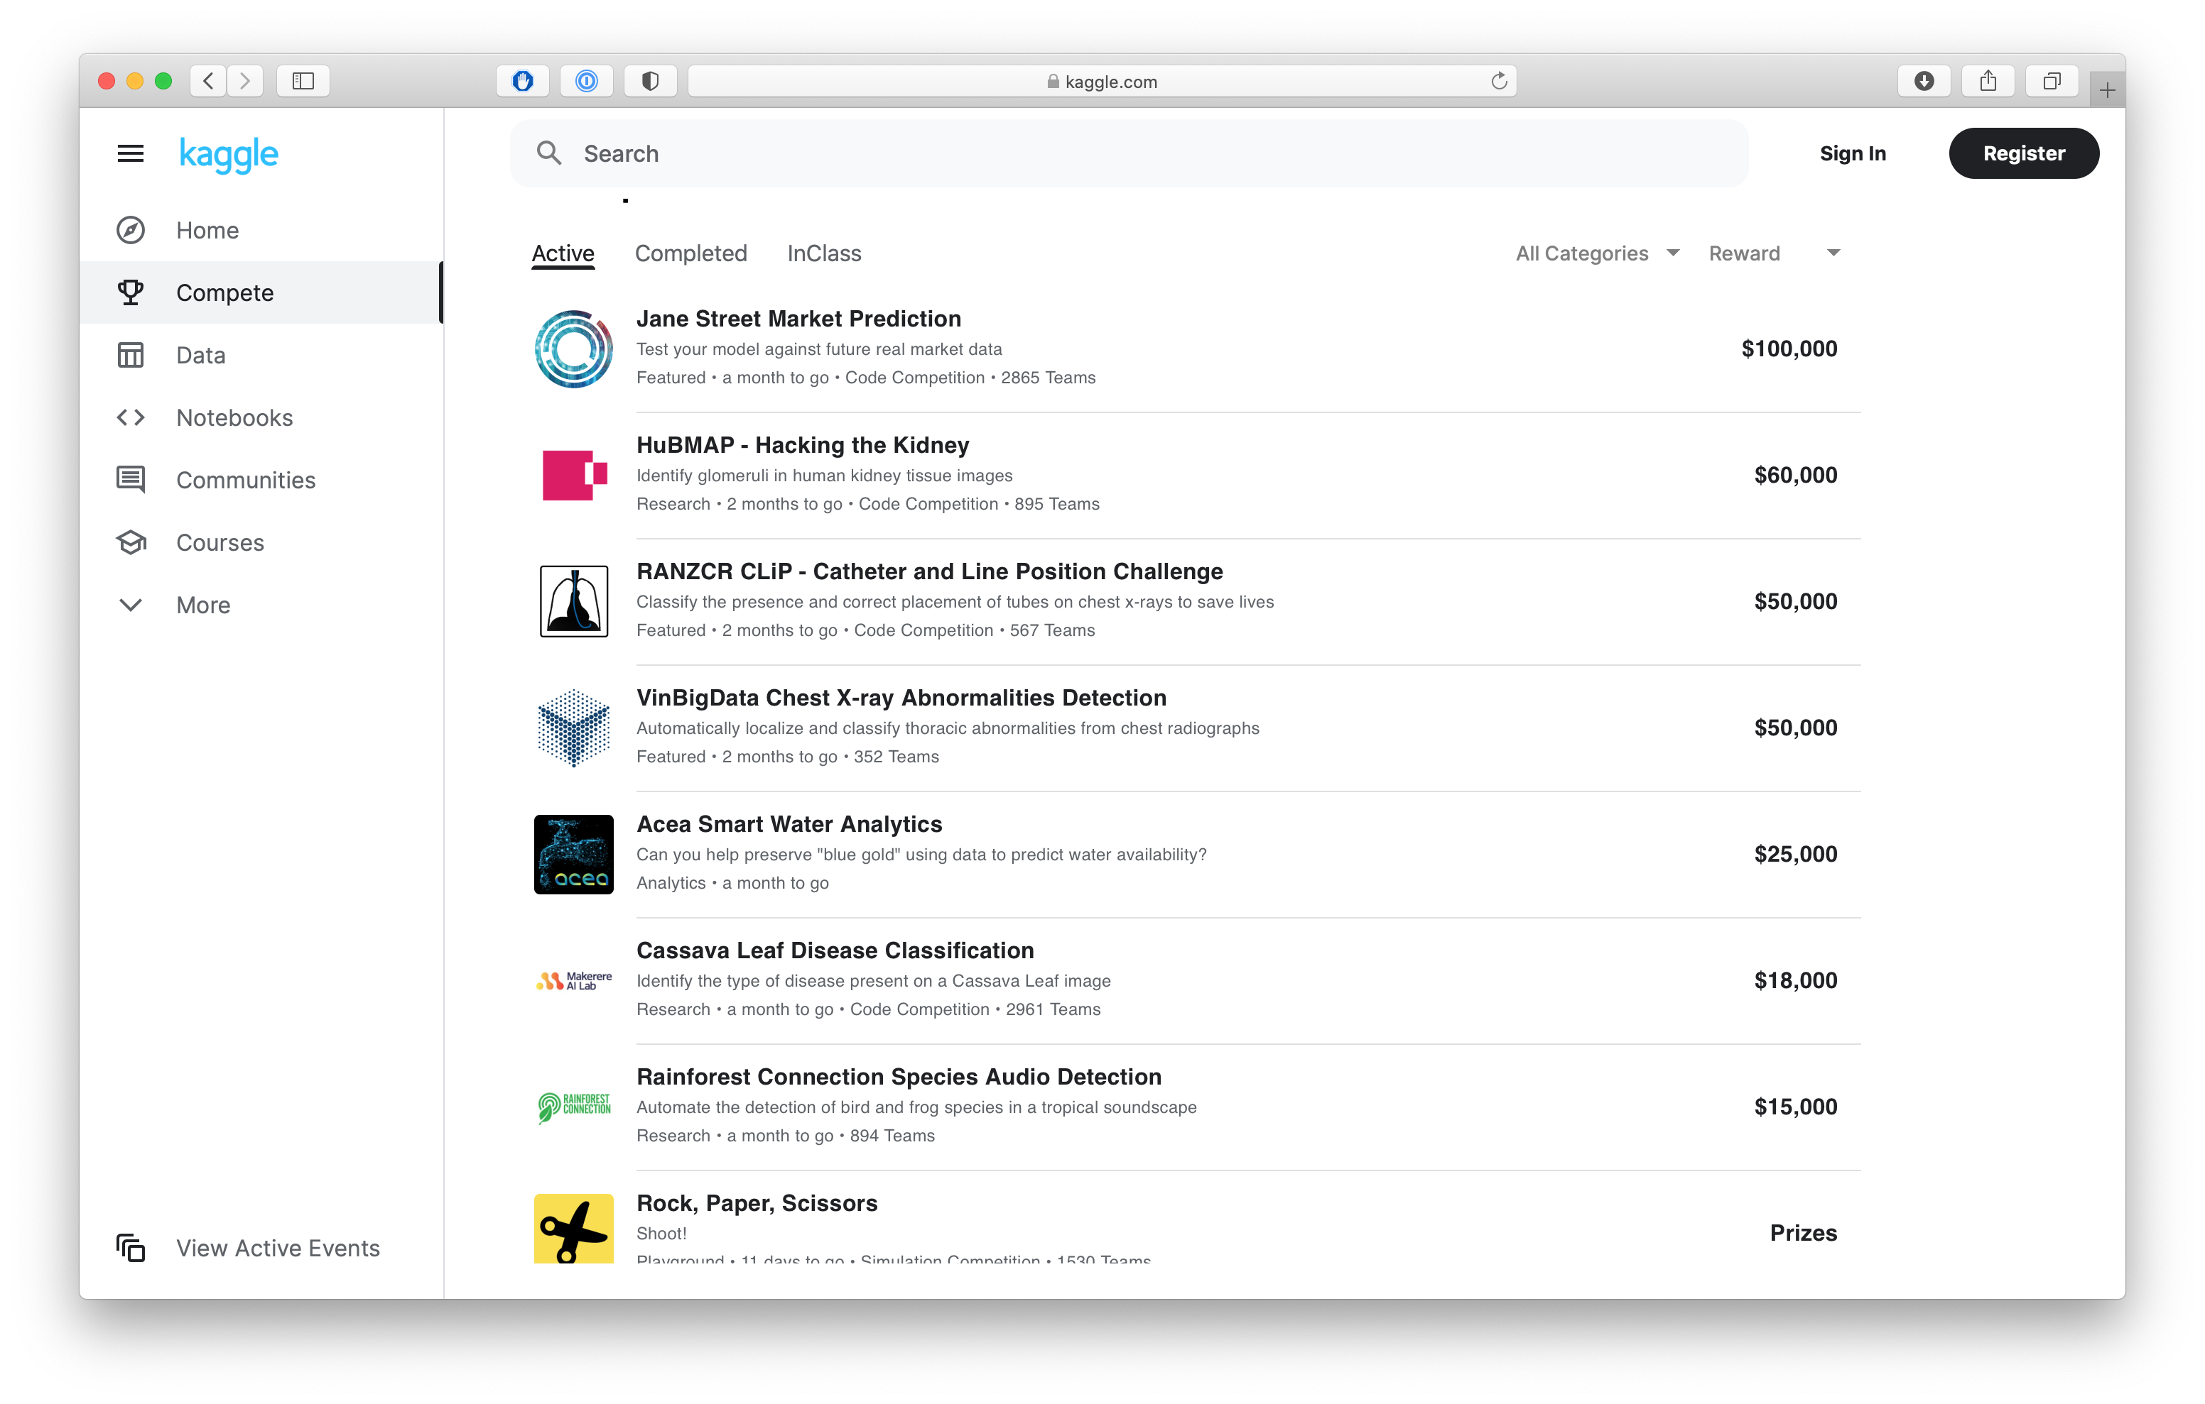

Slide 33
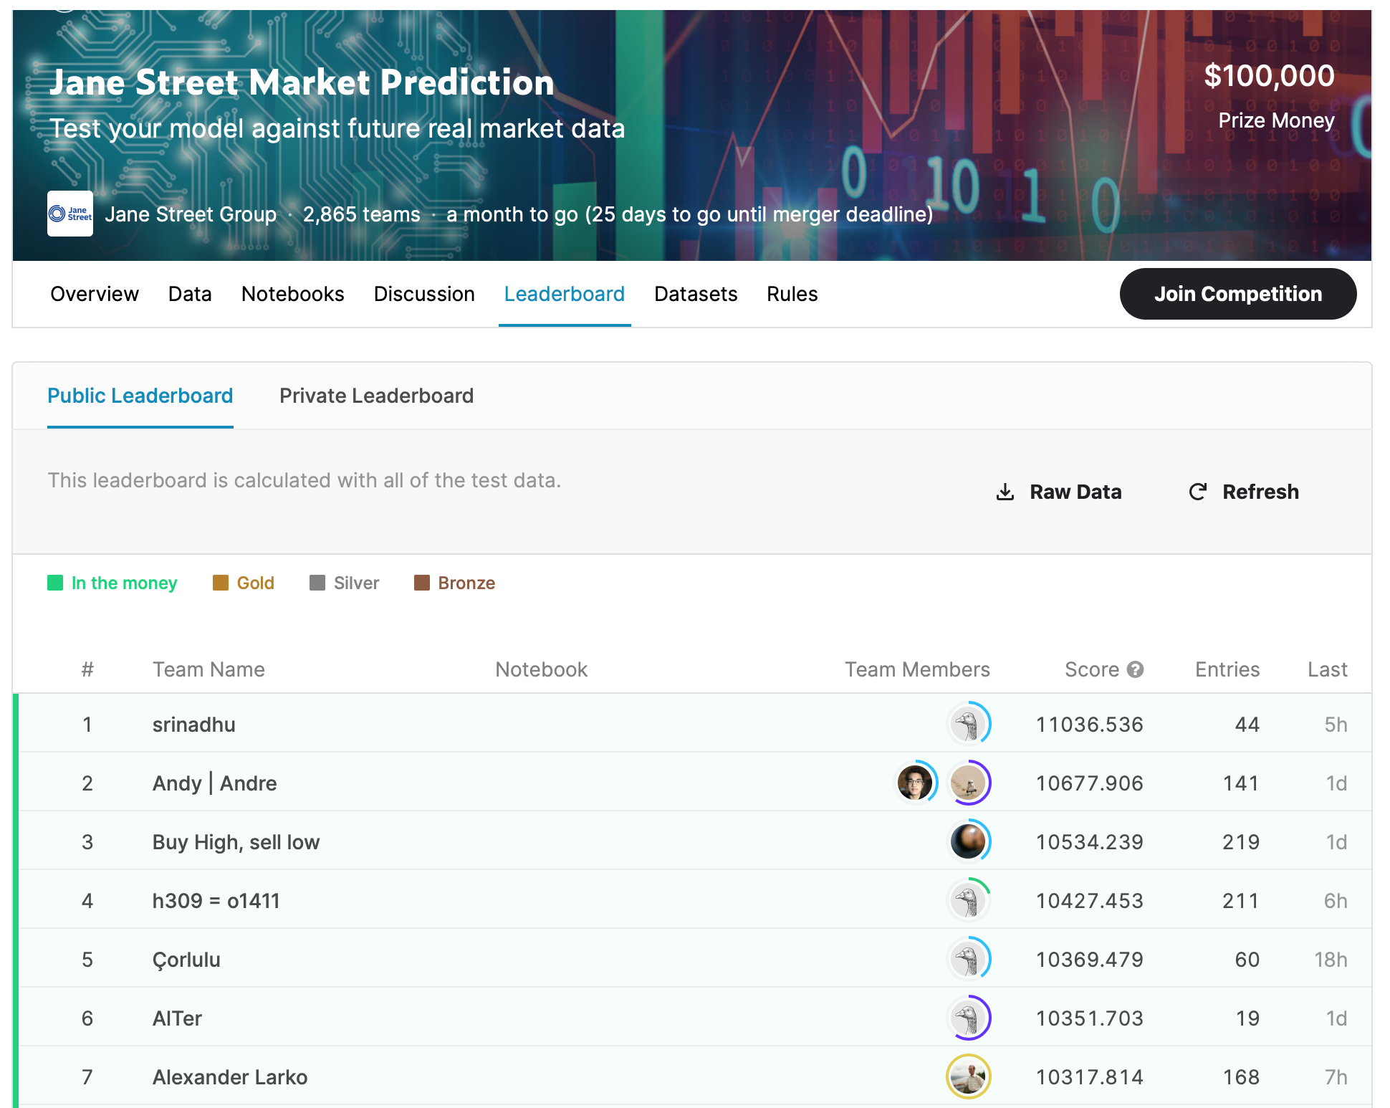

Slide 34
Games with a Purpose

Slide 35
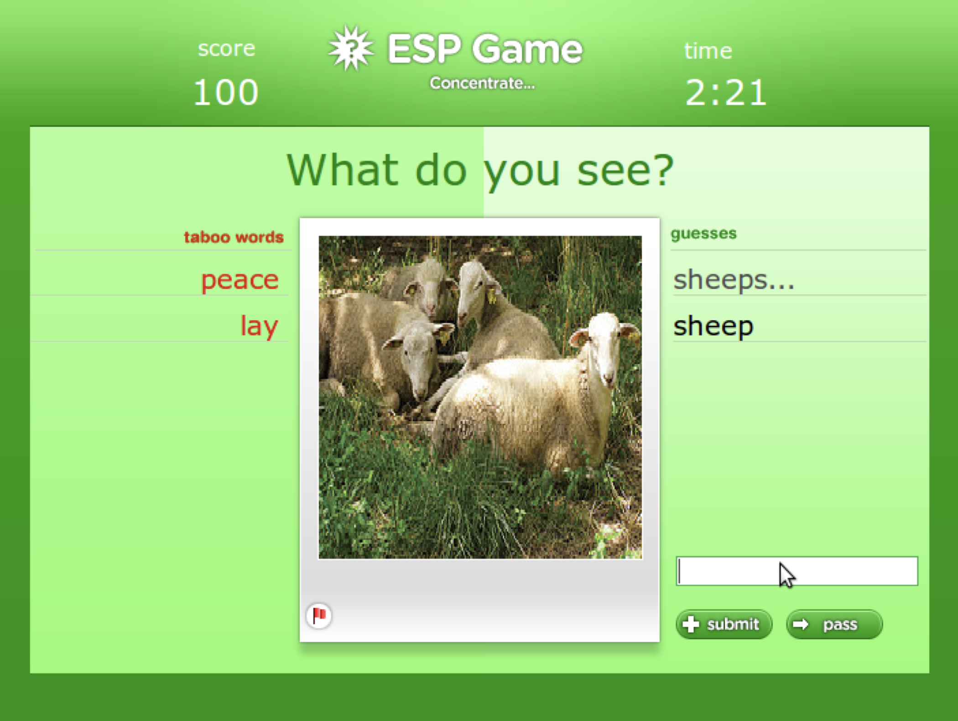

Slide 36


Slide 37
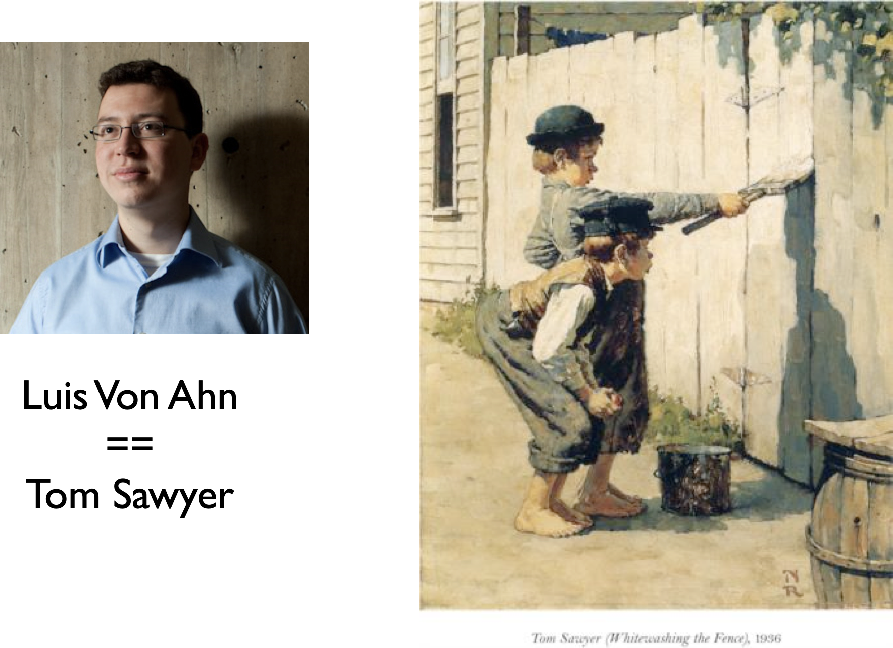

Slide 38

Real or Fake Text?
How good are you (and other humans) at knowing when text has been written by a computer? Is the computer better at generating convincing text if the topic is news, or short stories, or maybe presidential speeches?
http://roft.io

Slide 39
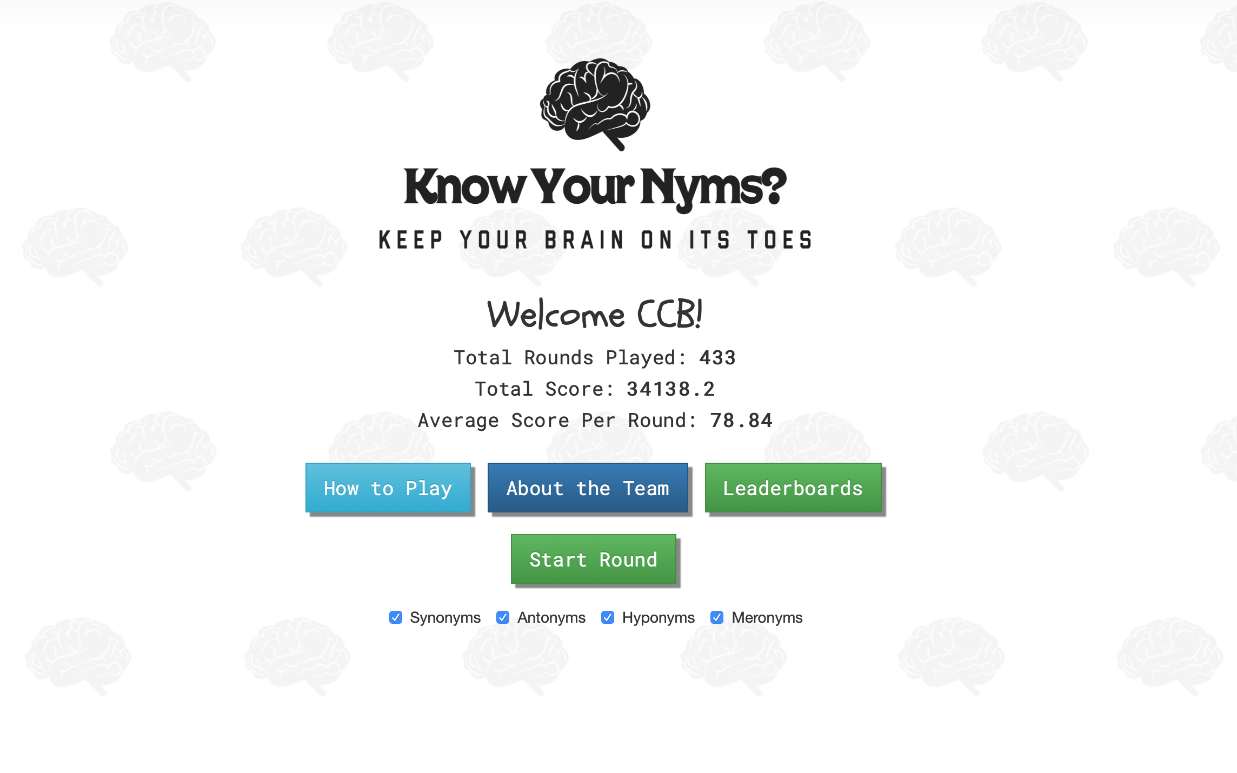
Know Your Nyms?
https://www.know-your-nyms.com

Slide 40
Implicit Work

Slide 41
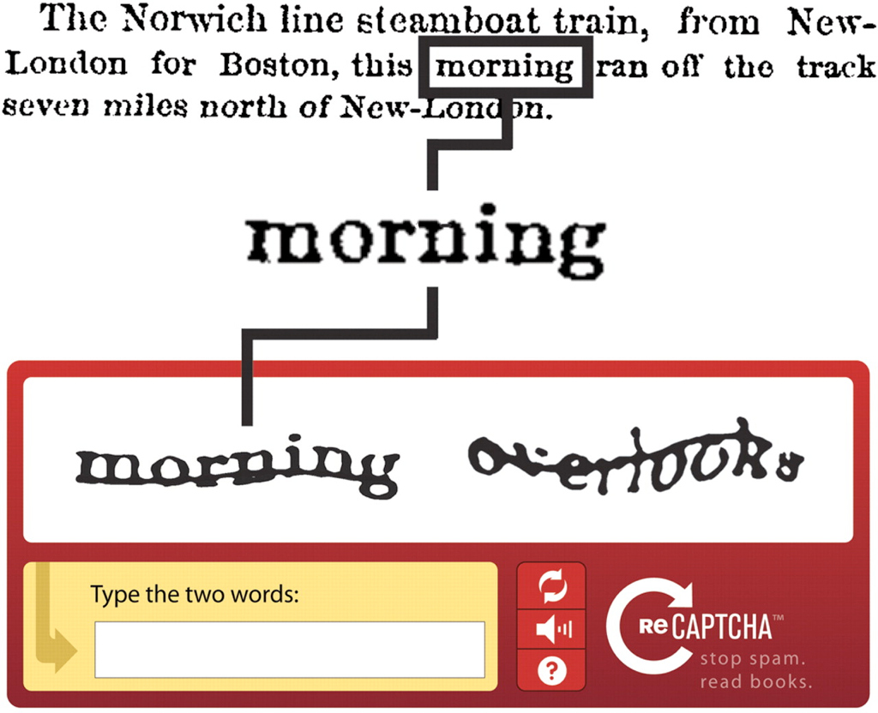
CAPTCHA
Notes:
A CAPTCHA (/kæp.tʃə/, a contrived acronym for "Completely Automated Public Turing test to tell Computers and Humans Apart") is a type of challenge–response test used in computing to determine whether or not the user is human.^{[1]}

Slide 42
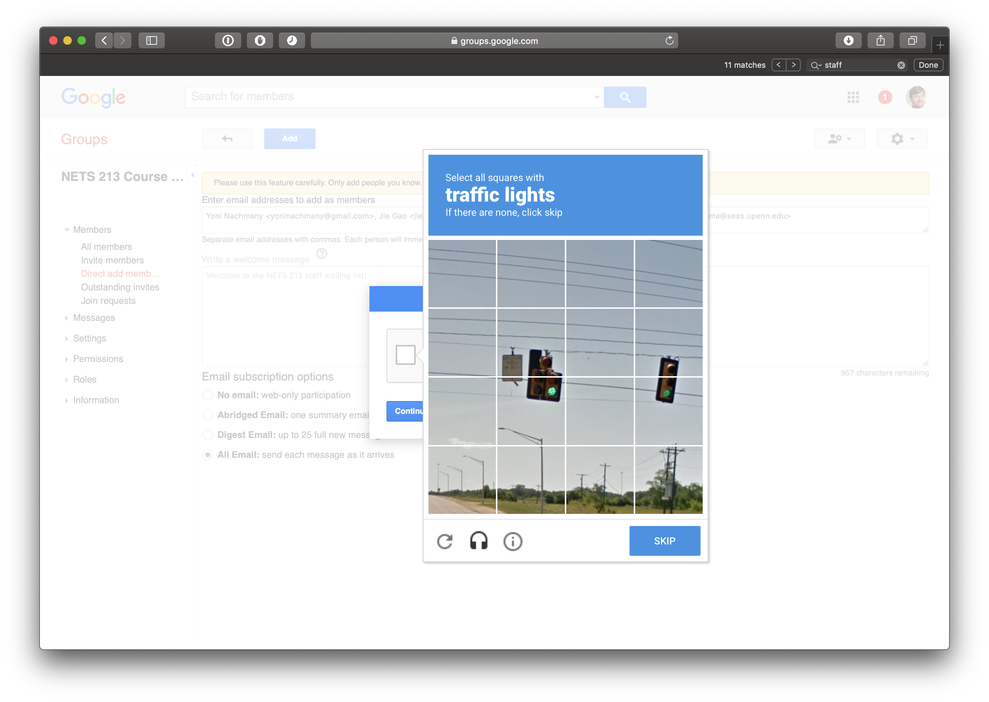

Slide 43
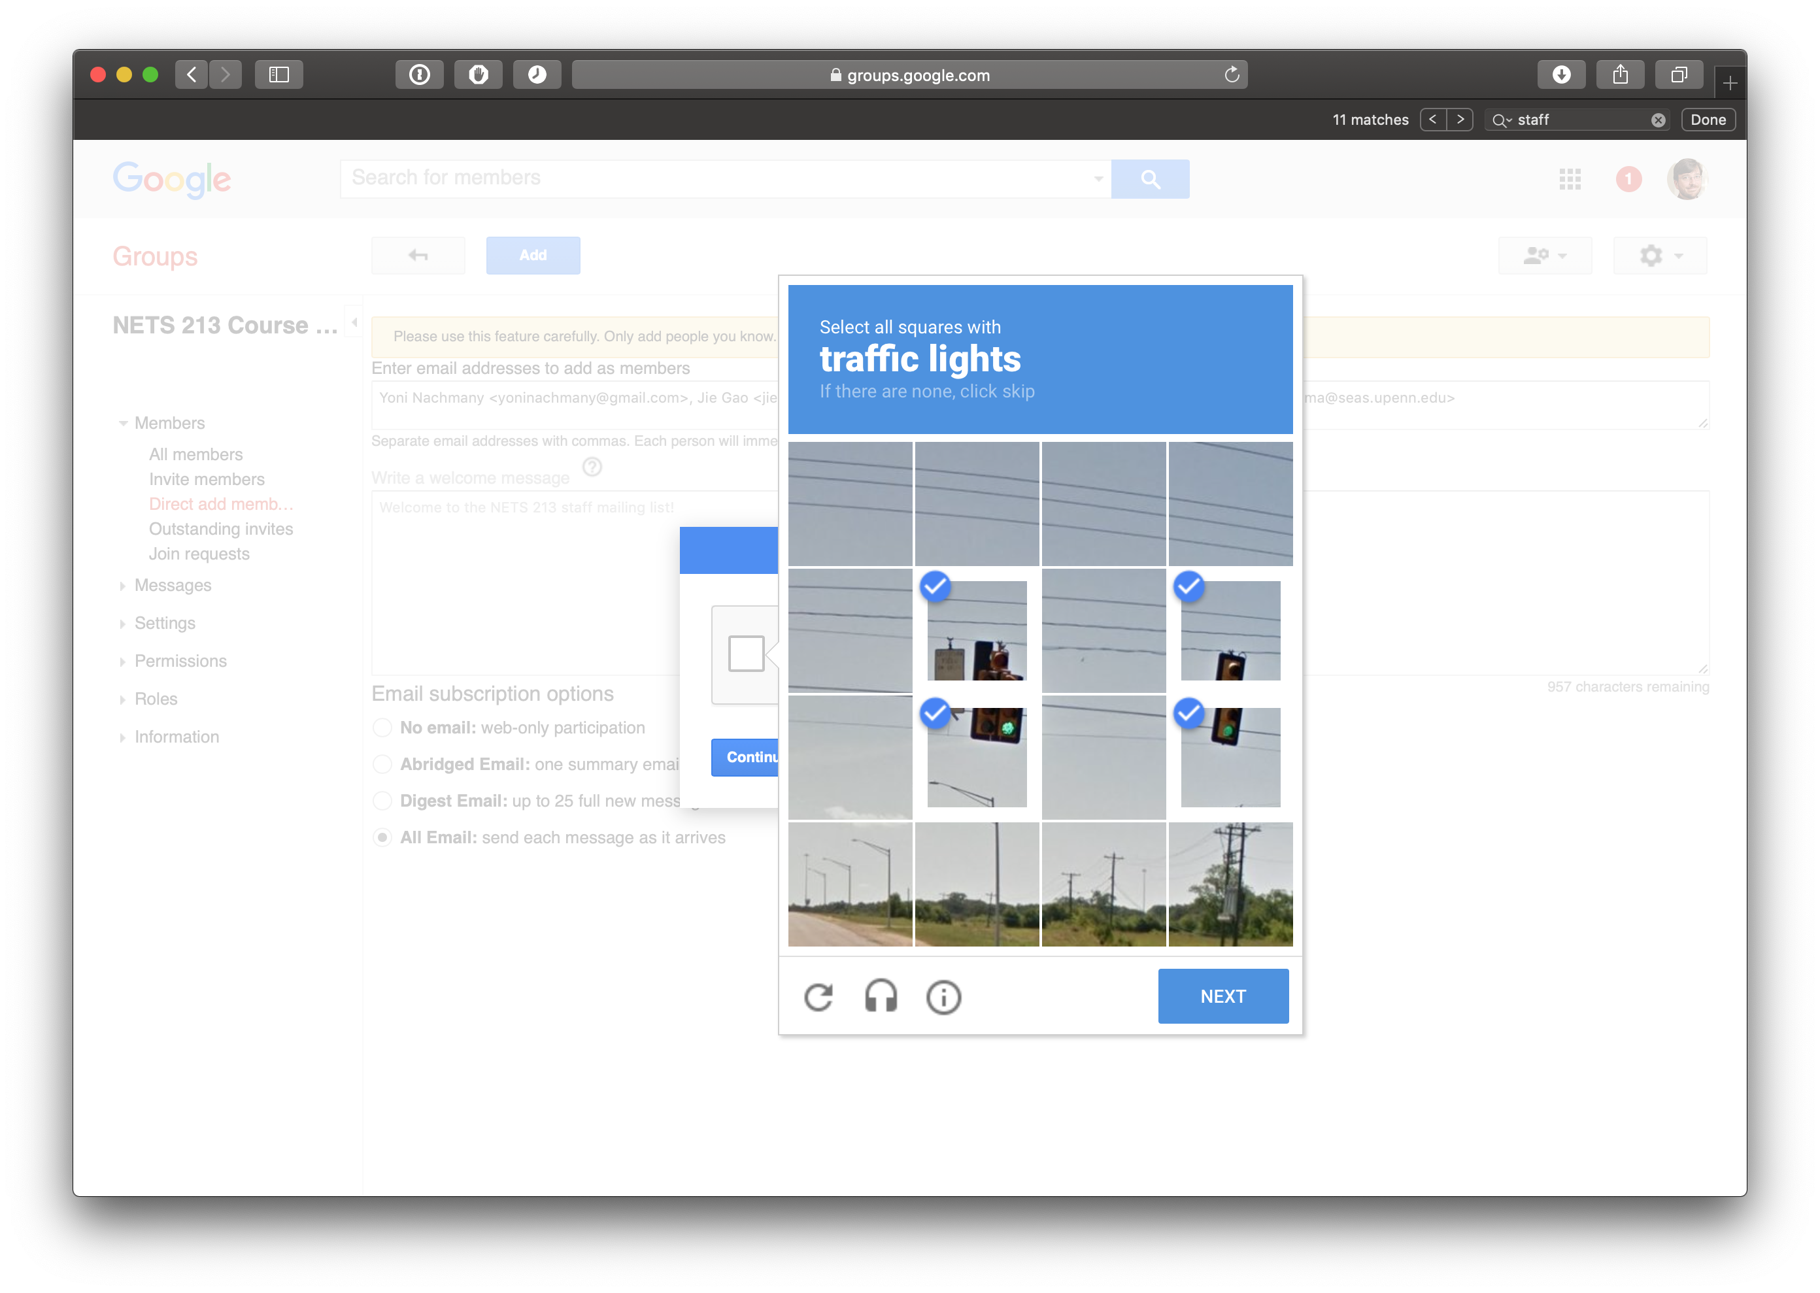

Slide 44
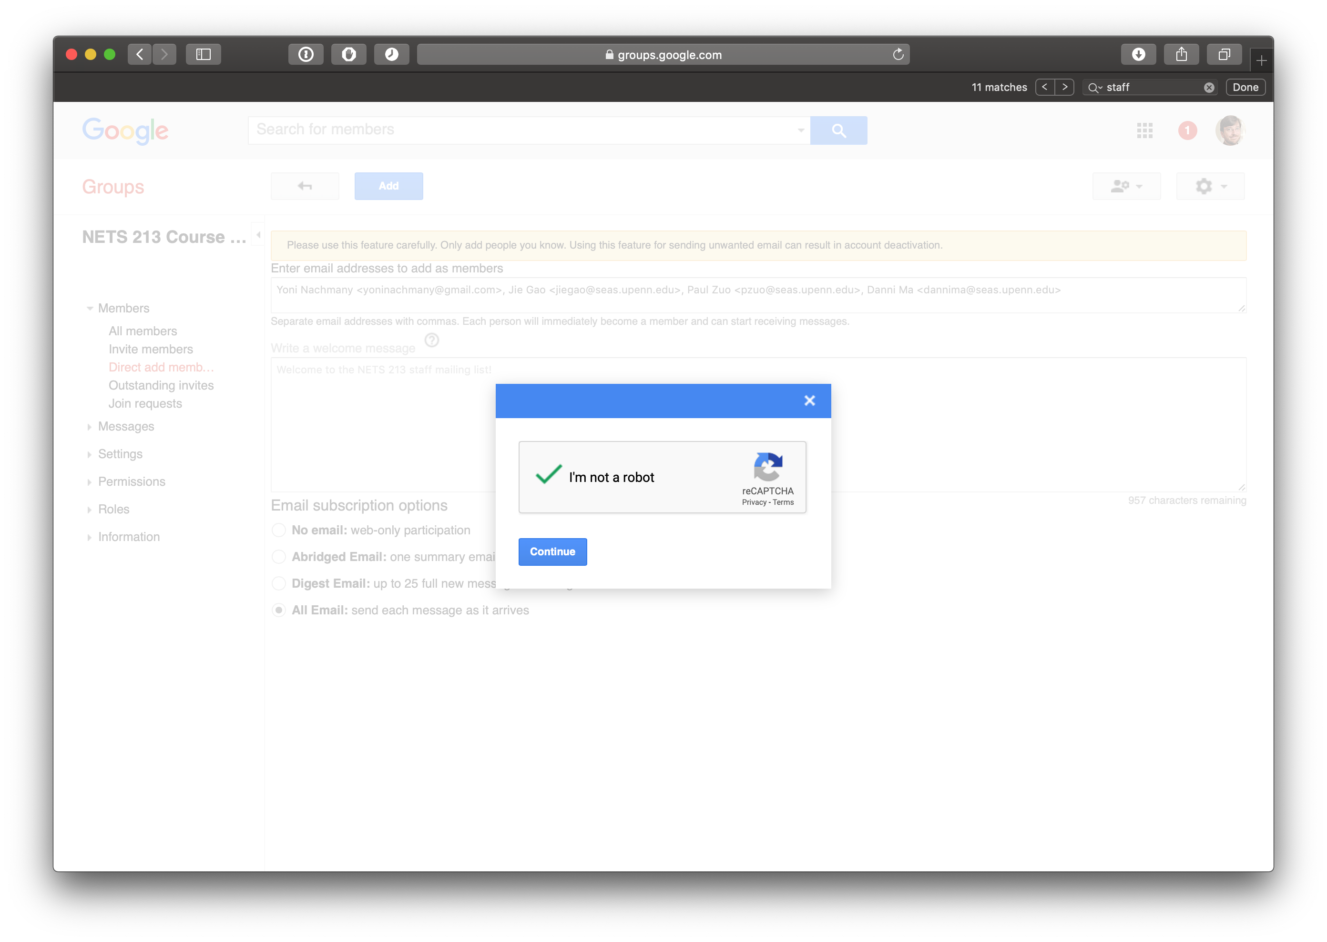

Slide 45
Microwork

Slide 46
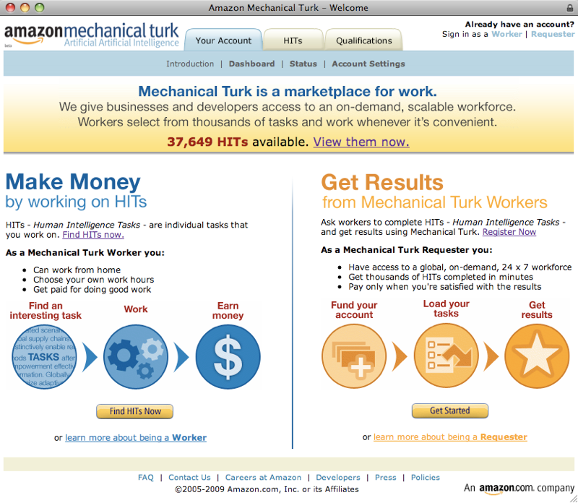

Slide 47
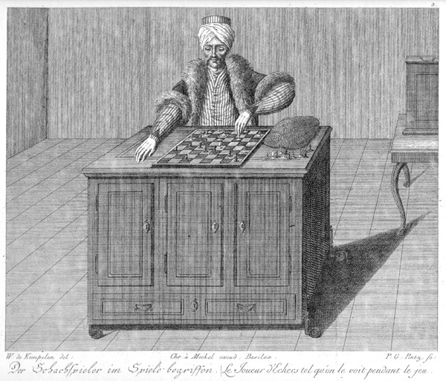

Slide 48
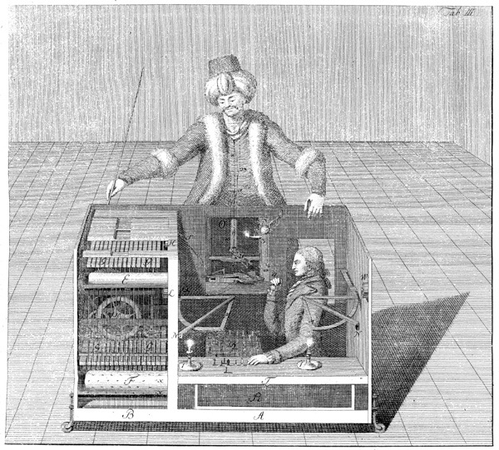

Slide 49
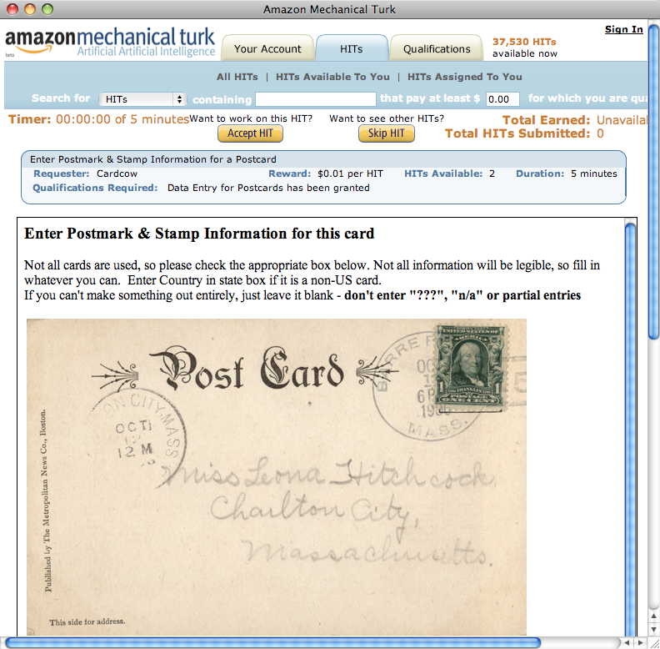
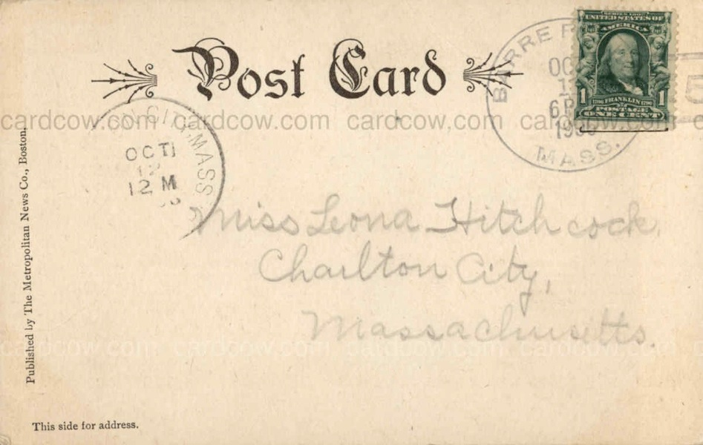


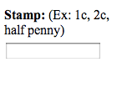

Slide 50
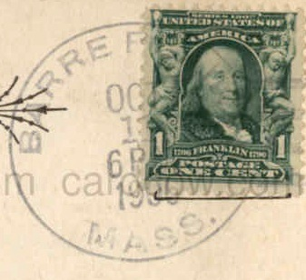
Postmark City:
Barre
Postmark State:
MA
Postmark Date:
Oct-11
Postmark Year:
1886
Stamp:
1c
$
0.
01

Slide 51
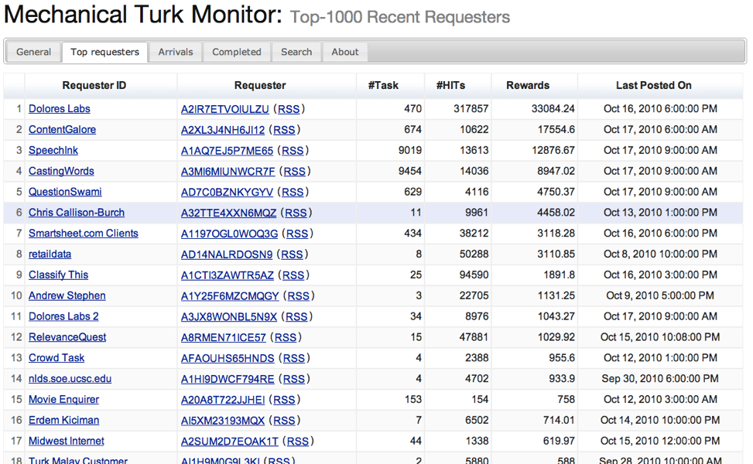

Slide 52

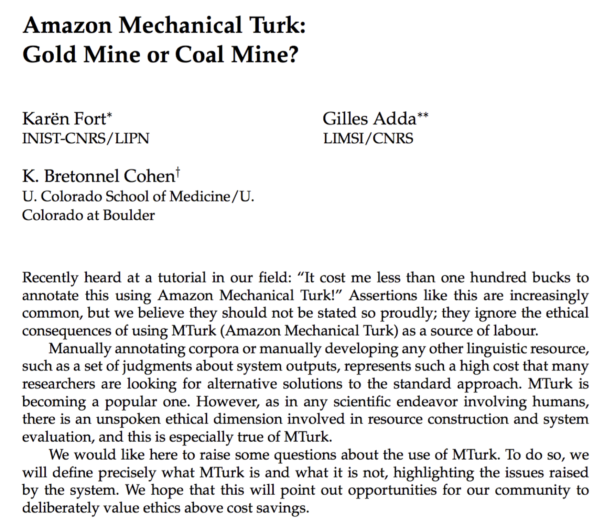

Ethical Questions about Amazon Mechanical Turk

Slide 53
Ethical Questions about Amazon Mechanical Turk
Here's an excerpt from an IRB application Chris Callison-Burch posted - "We will pay participants small sums of money to complete our tasks, ranging from $0.01 to $1. All participants can choose for themselves whether the compensation is fair, and opt not to do it if they deem the compensation to be too low. Amazon's Mechanical Turk has many other researchers and companies offering tasks, so we will offer compensation that is similar to what others offer."
He first refers to Amazon's Mechanical Turk as "an online labor market." And that, I agree with. It is an online labor market.
Requesters like him, and CrowdFlower, collude, explicitly or implicitly, to keep wages at a substandard level that is compatible with existence standard.
Unlike Jewels, I don't blame workers for taking low paying jobs. I can't blame a person for being needy enough to take what amounts to a crust of bread. I blame Chris Callison-Burch, and others like him, for keeping the standard wage at crust of bread level.

Slide 54
Ethical Questions about Amazon Mechanical Turk
I tried one of those to see, I gave it up at 4 minutes in and about 2/3 of the way through. For the whole hit, I'd have taken about 6 minutes. 10 hits an hour - $1.70 an hour. Restricted to U.S. residents.
This is far too low to be considered a fair wage for a U.S. resident. My performance may be very far off from what others can do. Perhaps I took 4 times or more as long as an average worker would.
My complaint is that any U.S. requester knows what wage rate is required for a U.S. resident to survive. We may not agree on an exact number. But as they say, I know a fair wage when I see it, and this is not it.
Mturk is actually much smaller than what it can appear to be. Something close to requester monopoly has the power to keep wages low. Requester co-operation, explicit or implicit, reinforces this.
Chris Callison-Burch is not unaware, I think, of the mechanics of the wage structure of Mturk.

Slide 55
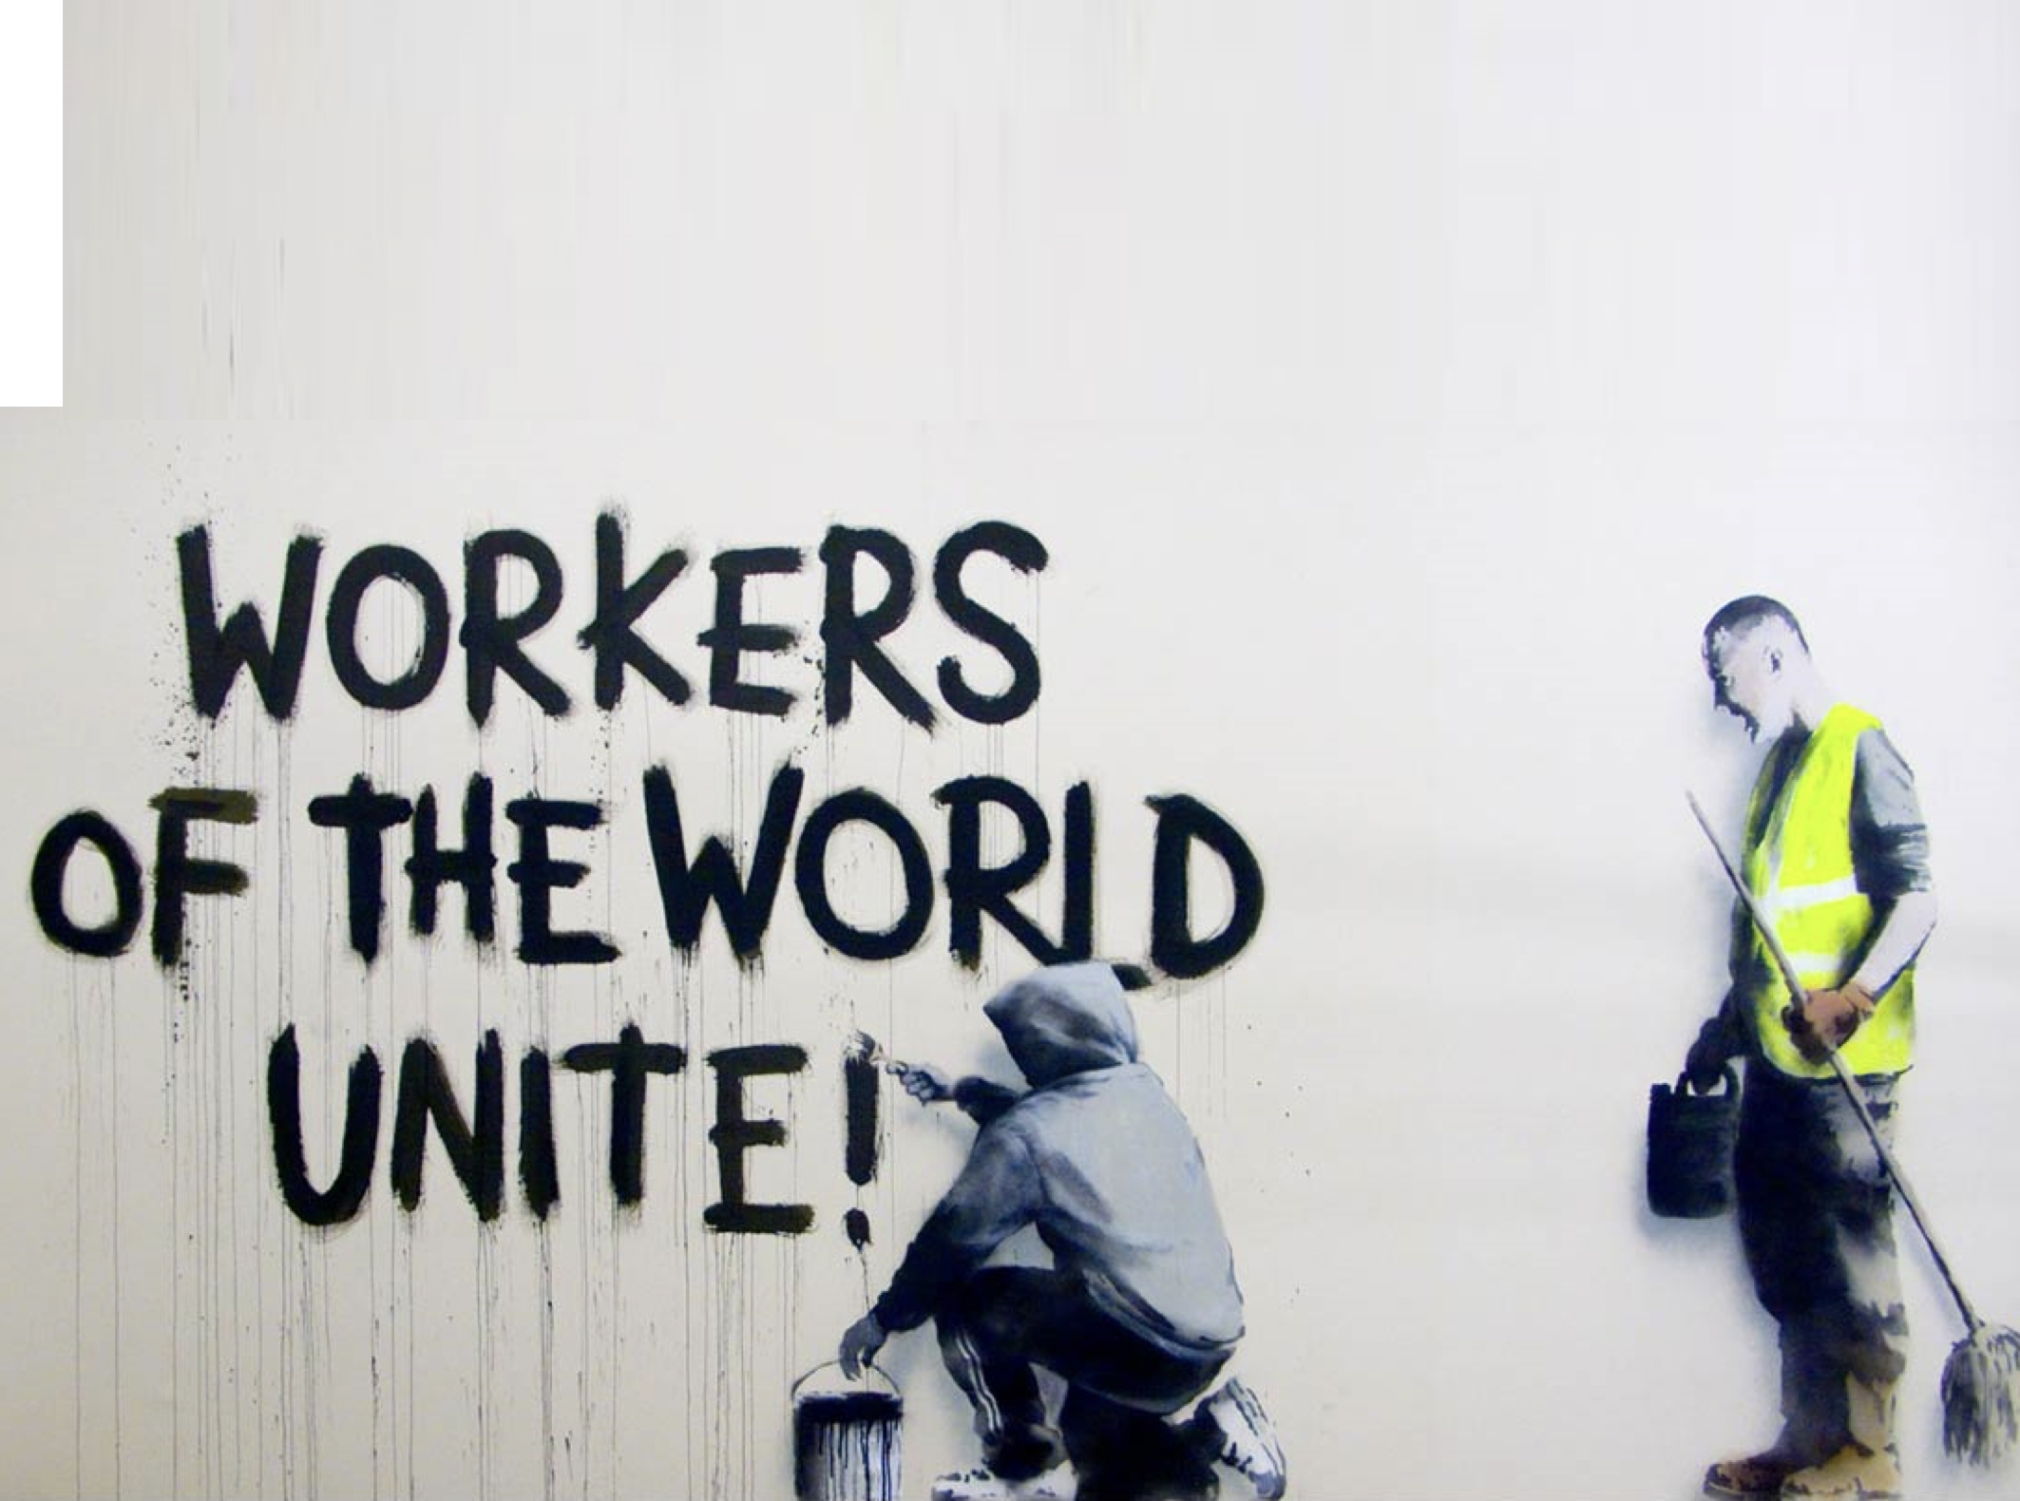

Slide 56
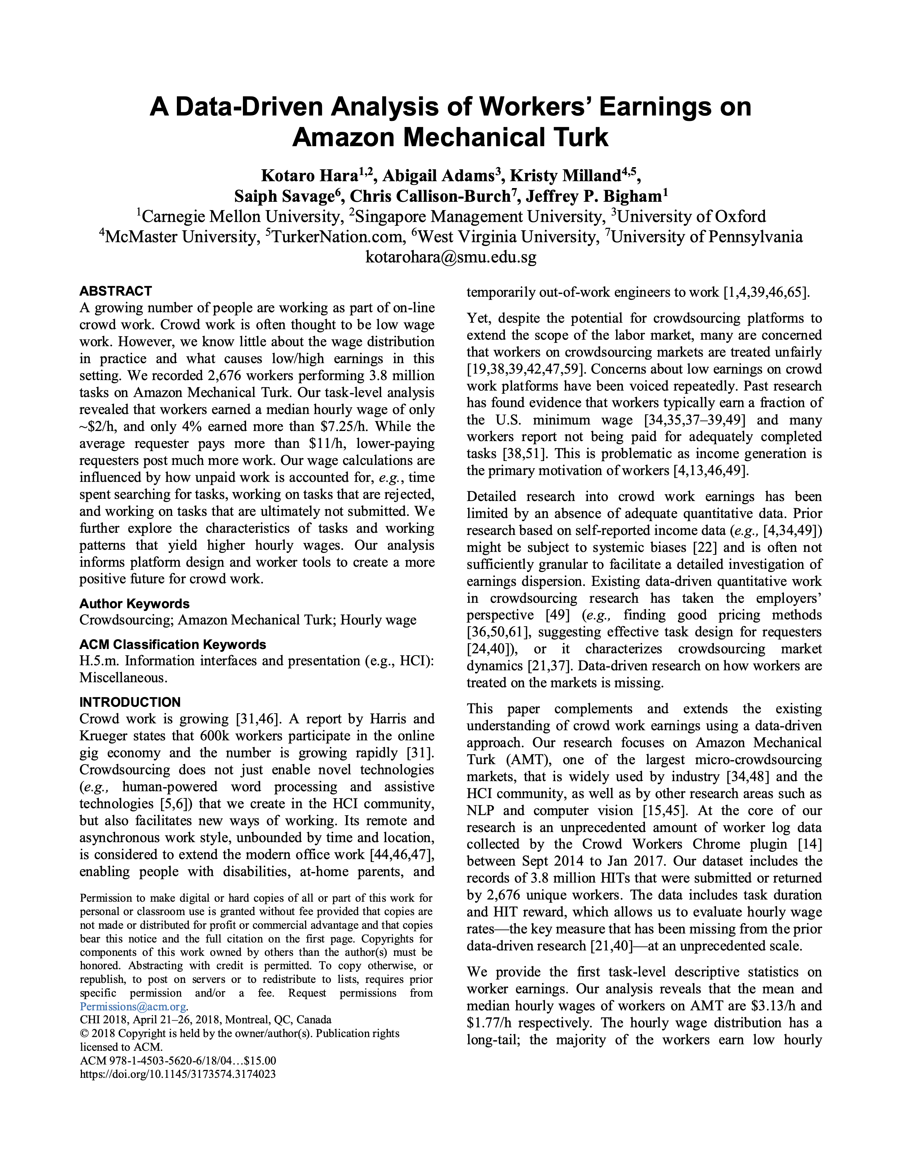

Slide 57
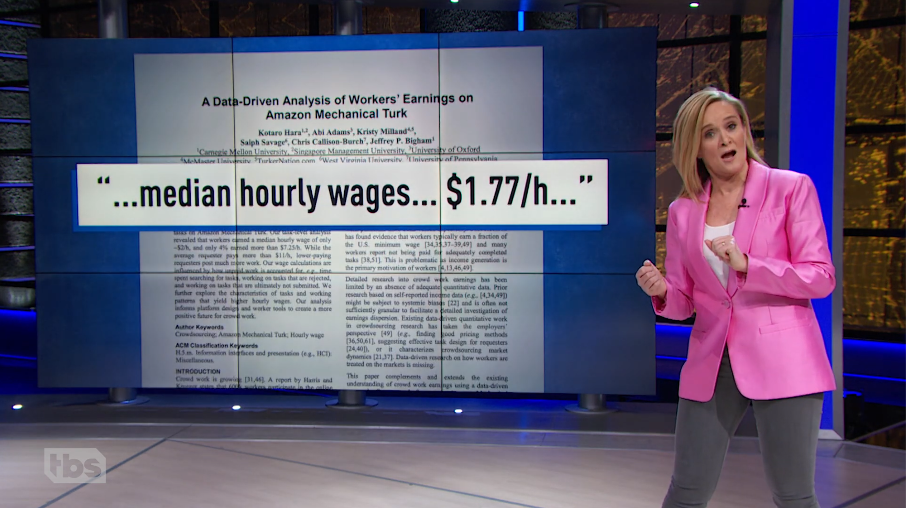
America’s Gig-Based Economy Gets Zero Stars | Full Frontal - Mar 11, 2020
Notes:
https://www.youtube.com/watch?v=u11DK9kMp5Y&t=96
Watch until 4:12

Slide 58
Use Cases

Slide 59
Use of MTurk-like systems in research
Participant pool for user studies, polling, cognitive science experiments
Annotation for machine learning tasks like computer vision or NLP
Human Computer Interaction: worker pools are hardwired into the UI
New Programming Languages Concepts
Study markets themselves for economics research, cost-optimization

Slide 60
Crowdsourcing and the Social Sciences
Social Psychology
From Buhrmester, Kwang, & Gosling (2011, Perspectives on Psychological Science) Amazon’s Mechanical Turk: A New Source of Inexpensive, Yet High-Quality, Data? :
Findings indicate that: (a) MTurk participants are slightly more representative of the U.S. population than are standard Internet samples and are significantly more diverse than typical American college samples; (b) participation is affected by compensation rate and task length but participants can still be recruited rapidly and inexpensively; (c) realistic compensation rates do not affect data quality; and (d) the data obtained are at least as reliable as those obtained via traditional methods.
Economics
From Horton, Rand & Zeckhauser (2010, Experimental Economics) – The Online Laboratory: Conducting Experiments in a Real Labor Market :
Online experiments can be just as valid as laboratory and ﬁeld experiments, while requiring far less money and time to design and to conduct. We describe the beneﬁts of conducting experiments in online labor markets and we replicate three classic experiments.
Clinical Psychology Management/Cognition Theoretical Biology
Examples from Gilad Fili Feldman’s blog: http://mgto.org/

Slide 61
Study Markets Themselves
What predictions of economics hold true on MTurk?
What incentives can we give to increase throughput, quality, worker retention?
What is the cost-optimal solution to a problem?

Slide 62
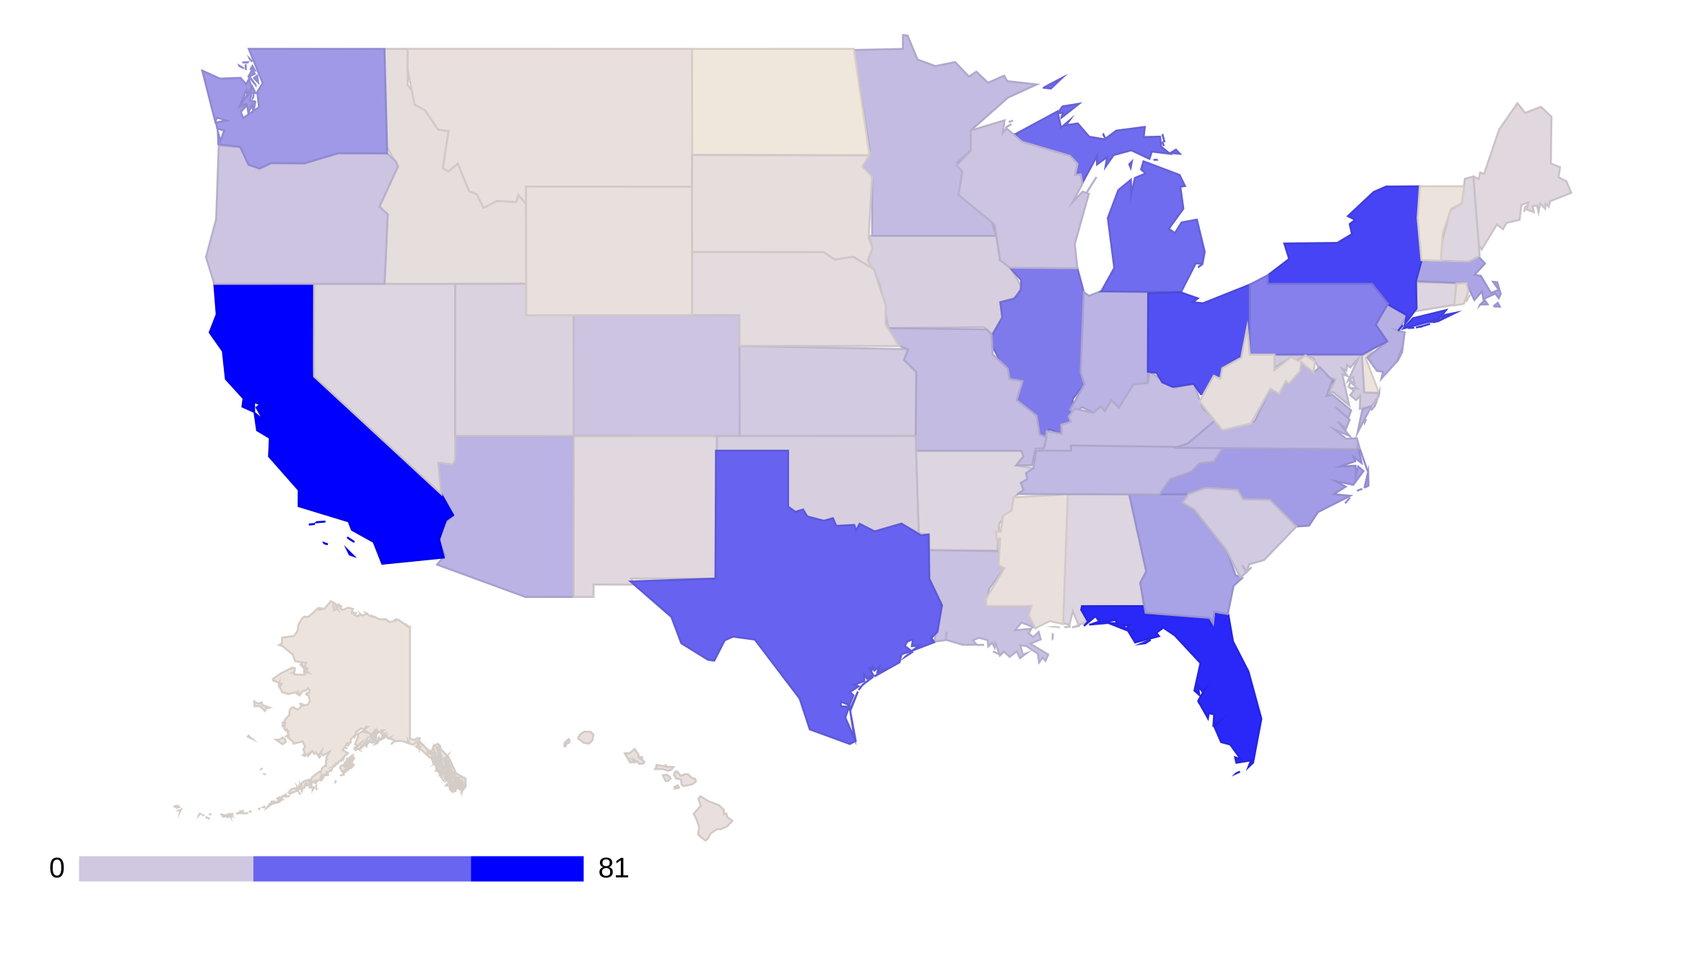
Notes:
Workers from 49 states, plus the District of Columbia. No one from North Dakota.

Slide 63
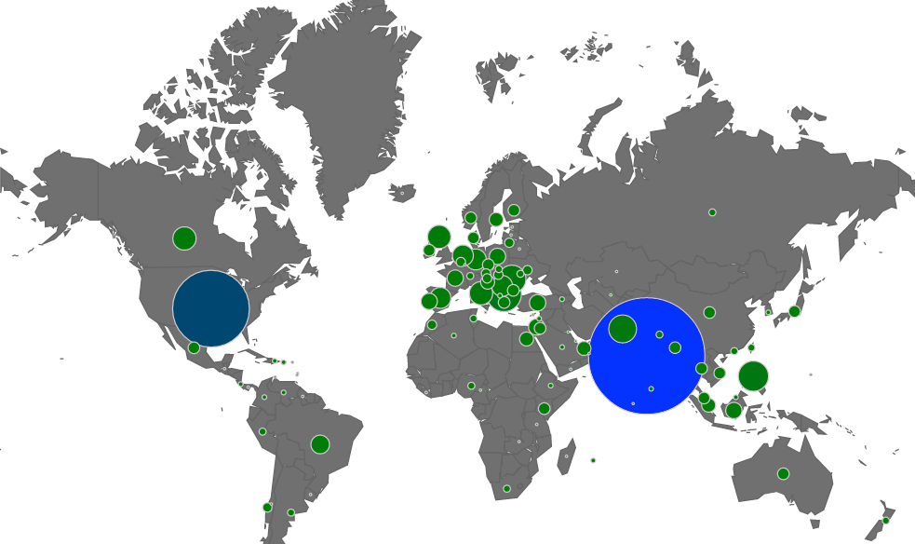
10
904
Yoruba
25
2022
125
4
Notes:
Census of over 5,284 bilingual workers on MTurk. Came from 111 countries. Size of circles represents number of workers.
India had 2,022 workers, the United States had 904, the Philippines had 147, Egypt had 25, Russia had 10, and Sri Lanka had 4.

Slide 64
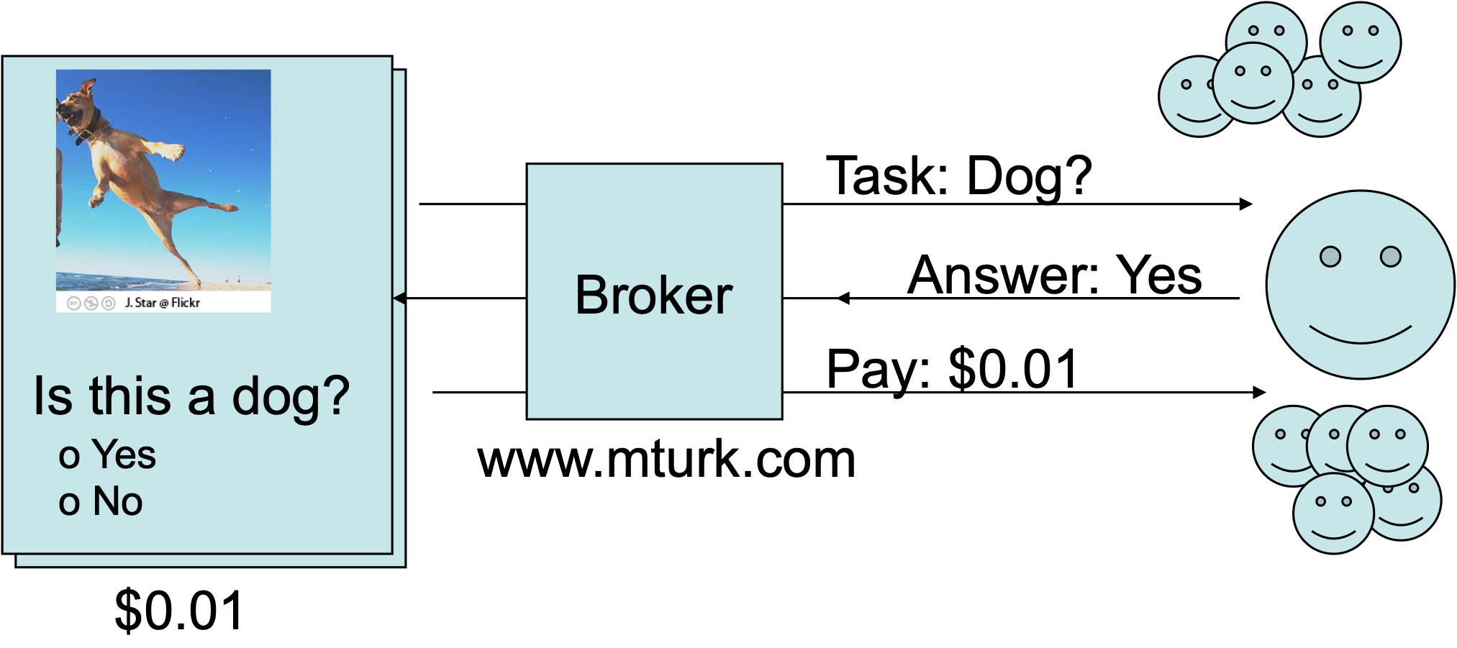
Annotation for machine learning / artificial intelligence tasks

Slide 65
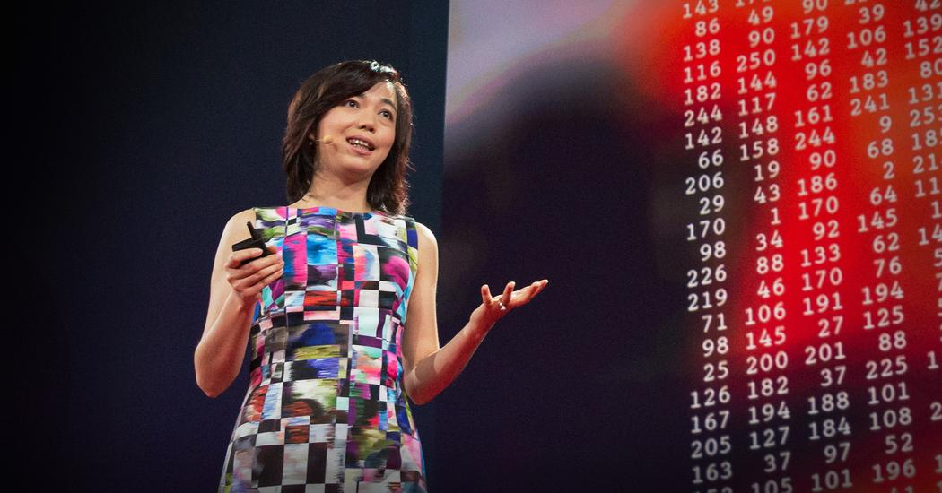
“We decided we wanted to do something that was completely historically unprecedented. We’re going to map out the entire world of objects.” The resulting dataset was called ImageNet.
Notes:
Used MTurk
ImageNet aims to populate the majority of the 80,000 synsets of WordNet with an average of 500-1000 clean and full resolution images. 5247 synsets and 3.2 million images in total.
Quote from: https://qz.com/1034972/the-data-that-changed-the-direction-of-ai-research-and-possibly-the-world/
Image credit: TED
https://www.ted.com/talks/fei_fei_li_how_we_re_teaching_computers_to_understand_pictures

Slide 66


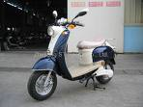
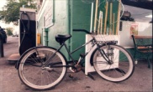




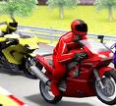
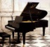













































































Moped
Bicycle
Motorbike
Go-cart
Trail Bike
Car, auto
Helicopter
Notes:
When it was Published in 2009, ImageNet had collected 500-1000 clean and full resolution images for 5247 works, with 3.2 annotated million images in total.
https://ieeexplore.ieee.org/abstract/document/5206848?casa_token=TEImYbiV8EkAAAAA:djnI9b233126o-JjuNaD7mYg51QJ7YjXZ_dwsa2YvA6MkUe9XZVTOzRFMIMsoD9LM0QZVkvlZk0

Slide 67




Slide 68

Human Computer Interaction
VizWiz - best paper award at UIST 2010-
Mobile service that aids bind uses with “visual questions” in near-realtime
https://www.youtube.com/watch?v=EtfriMJQ0_M
Notes:
https://www.youtube.com/watch?v=EtfriMJQ0_M

Slide 69
Human Computer Interaction
Soylent - a Word Processor that is made of people http://projects.csail.mit.edu/soylent/
Uses workers on MTurk to perform several tasks
Shortn: reduce the length of a paragraph
Crowdproof: proofread and correct errors
The human macro: A natural language interface to making changes to a document
Notes:
https://www.youtube.com/watch?v=EtfriMJQ0_M

Slide 70

New Programming Languages Concepts

Slide 71

New Programming Languages Concepts
Notes:
Latency
Cost
Parallelization
Non-determinism
Iterative improvement

Slide 72
What will we cover in this class (and should you take it)?

Slide 73
Topics
Taxonomy of crowdsourcing and human computation
Crowdsourcing platforms like Mechanical Turk and CrowdFlower
Programming concepts for human computation
The economics of crowdsourcing
Crowdsourcing and machine learning
Applications to human computer interaction
Crowdsourcing and social science

Slide 74
Who should take this class
Anyone who wants to be on the cutting edge of this new field
Entrepreneurial students who want to start their own companies
Students from the business school who want to experiment with markets
Students from the social sciences who want to conduct large-scale students with people

Slide 75
Homework assignments
Weekly assignments | Writing and Coding
Video presentations | Company profile, project pitch
Final project | Self-designed, group projects
Final presentation | Show off your work
Participation | Help write & improve lecture notes

Slide 76

Example Final Project
https://vimeo.com/334828345
Notes:
https://vimeo.com/334828345

Slide 77

Example Final Project
https://vimeo.com/334843343
Notes:
https://vimeo.com/334828345

Slide 78
How much programming is required?
Programming assignments are in Python
We provide code that you modify
We want everyone to be able to participate, regardless of programming experience
For most assignments, you can work with partners (turn in only one assignment - you’ll both get the same grade)

Slide 79
What will you get out of this class?
Understanding of an emerging field of CS
Basic python and machine learning skills
Ideas that you could transform into a startup company or academic research
A new way of thinking about collective decision making by companies and countries

Slide 80
HW: Sign up to be a Mechanical Turk Worker
crowdsourcing-class.org

